Slide 1


May 14, 2025
Presented by
Melissa Aguero Ramirez
HR Consultant & Talent Development Director

Slide 2


Slide 3

56% of SubManagers have 1-3 years of experience working with substitute teachers
44% of districts conducted BTS trainings
76% of districts utilize Red Rover or “other” system
63% of districts employ 101-500 substitute teachers

Slide 4
83% of districts interview substitute teachers prior to hiring them
Job offers are usually made via email or application software
Most substitute teachers work 7 hours per day
Substitute teacher campus contacts do not get paid extra for these duties

Slide 5
90% of districts provide professional development to their instructional aides
50% - 75% of substitutes teachers are degreed but not teacher certified at majority of districts
80% of districts hire substitute teachers year round

Slide 6
Substitute Teacher Appreciation
Training
Substitute teacher of the month
Shout outs in newsletter
Celebrate national substitute teacher day
Lunch tickets
Words of appreciation
Substitute teacher of the year
Bonus for working more than 70 hours
Incentive pay for working Mondays and Fridays
End of year incentive
Substitute teacher appreciation at end of the year

Slide 7
85% of respondents said that Principals/Asst. Principals visit substitute teacher classrooms
100% of respondents stated that teachers are required to leave lesson plans
92% of districts do NOT have a SubTaskForce
90% of districts do NOT evaluate substitute teachers

Slide 8
May Checklist
STEDI Surveys
Letter of Reasonable Assurance
Notify substitute teachers of continued employment for next school year
confirm continued employment interest
Initiate planning for Back to School (BTS) trainings (site, date/times based on instructional calendar, etc.)
Order ID badges, substitute teacher related items to replenish current school year use
Review fill rates
Ensure compliance with ACA requirements

Slide 9

Letter of reasonable assurance

Slide 10



End of Year Surveys
Substitute Teacher
Permanent Teachers
https://www.surveymonkey.com/r/STEDI-SubSurvey
https://www.surveymonkey.com/r/Fill-RateTeacher
School Staff
Principals
https://www.surveymonkey.com/r/Fill-RateStaff
https://www.surveymonkey.com/r/Fill-RatePrincipal

Slide 11

June Checklist
Convene
Convene Substitute Task Force to review previous school year and make recommendations for next school year
Verify
Verify employee handbook is updated
Purge
Purge substitute teacher list based on continued interest
Update
Update employee forms (as needed)

Slide 12
SubTaskForce
Campus Substitute Teacher contact
Principal
Staff development
Permanent Teacher
Substitute Teacher
Technology
Finance
HR

Slide 13
Topics to discuss
STEDI Survey Results
Substitute Teachers – staffing needs, recruiting and training
Teacher attendance
Culture (SubReady) - preparing students, facility, staff and Principals
SubAppreciation
District/organizational – practices, policies, procedures
SWOT Analysis

Slide 14


Slide 15
Schedule
August 28, 2024 (Wednesday) February 12, 2025 (Wednesday)
September 20, 2024 (Friday) March 11, 2025 **
October 22, 2024 (Tuesday) April 11, 2025 (Friday)
November 19, 2024 (Tuesday) May 14, 2025 (Wednesday)
December 4, 2024** UPDATE June 25, 2025 (Wednesday) UPDATE
January 16, 2025 (Thursday) July 17, 2025 (Thursday)

Slide 16
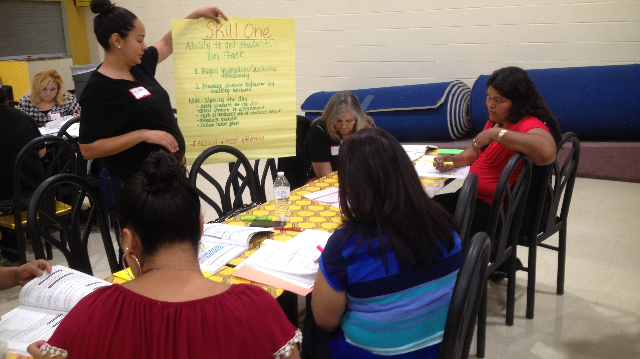
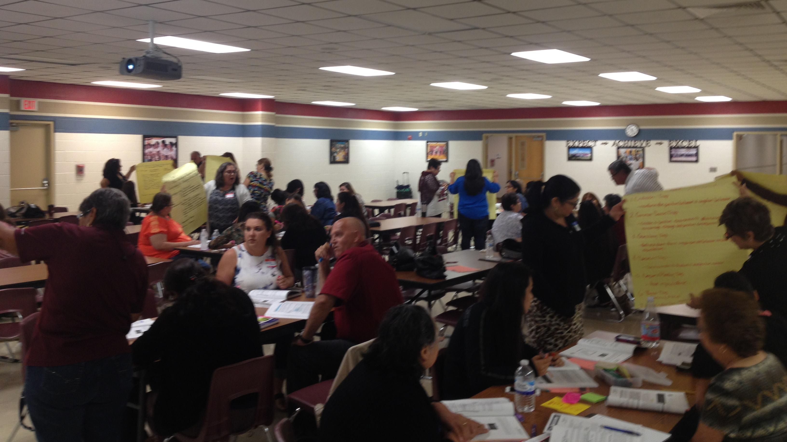
STEDI support
Online training
  Substitute teachers
  Classroom management for Teachers
  Special education settings
On site training
  Substitute teachers
  Instructional aides

Slide 17
New look for diplomas for online training
Picture?

Slide 18



Slide 19
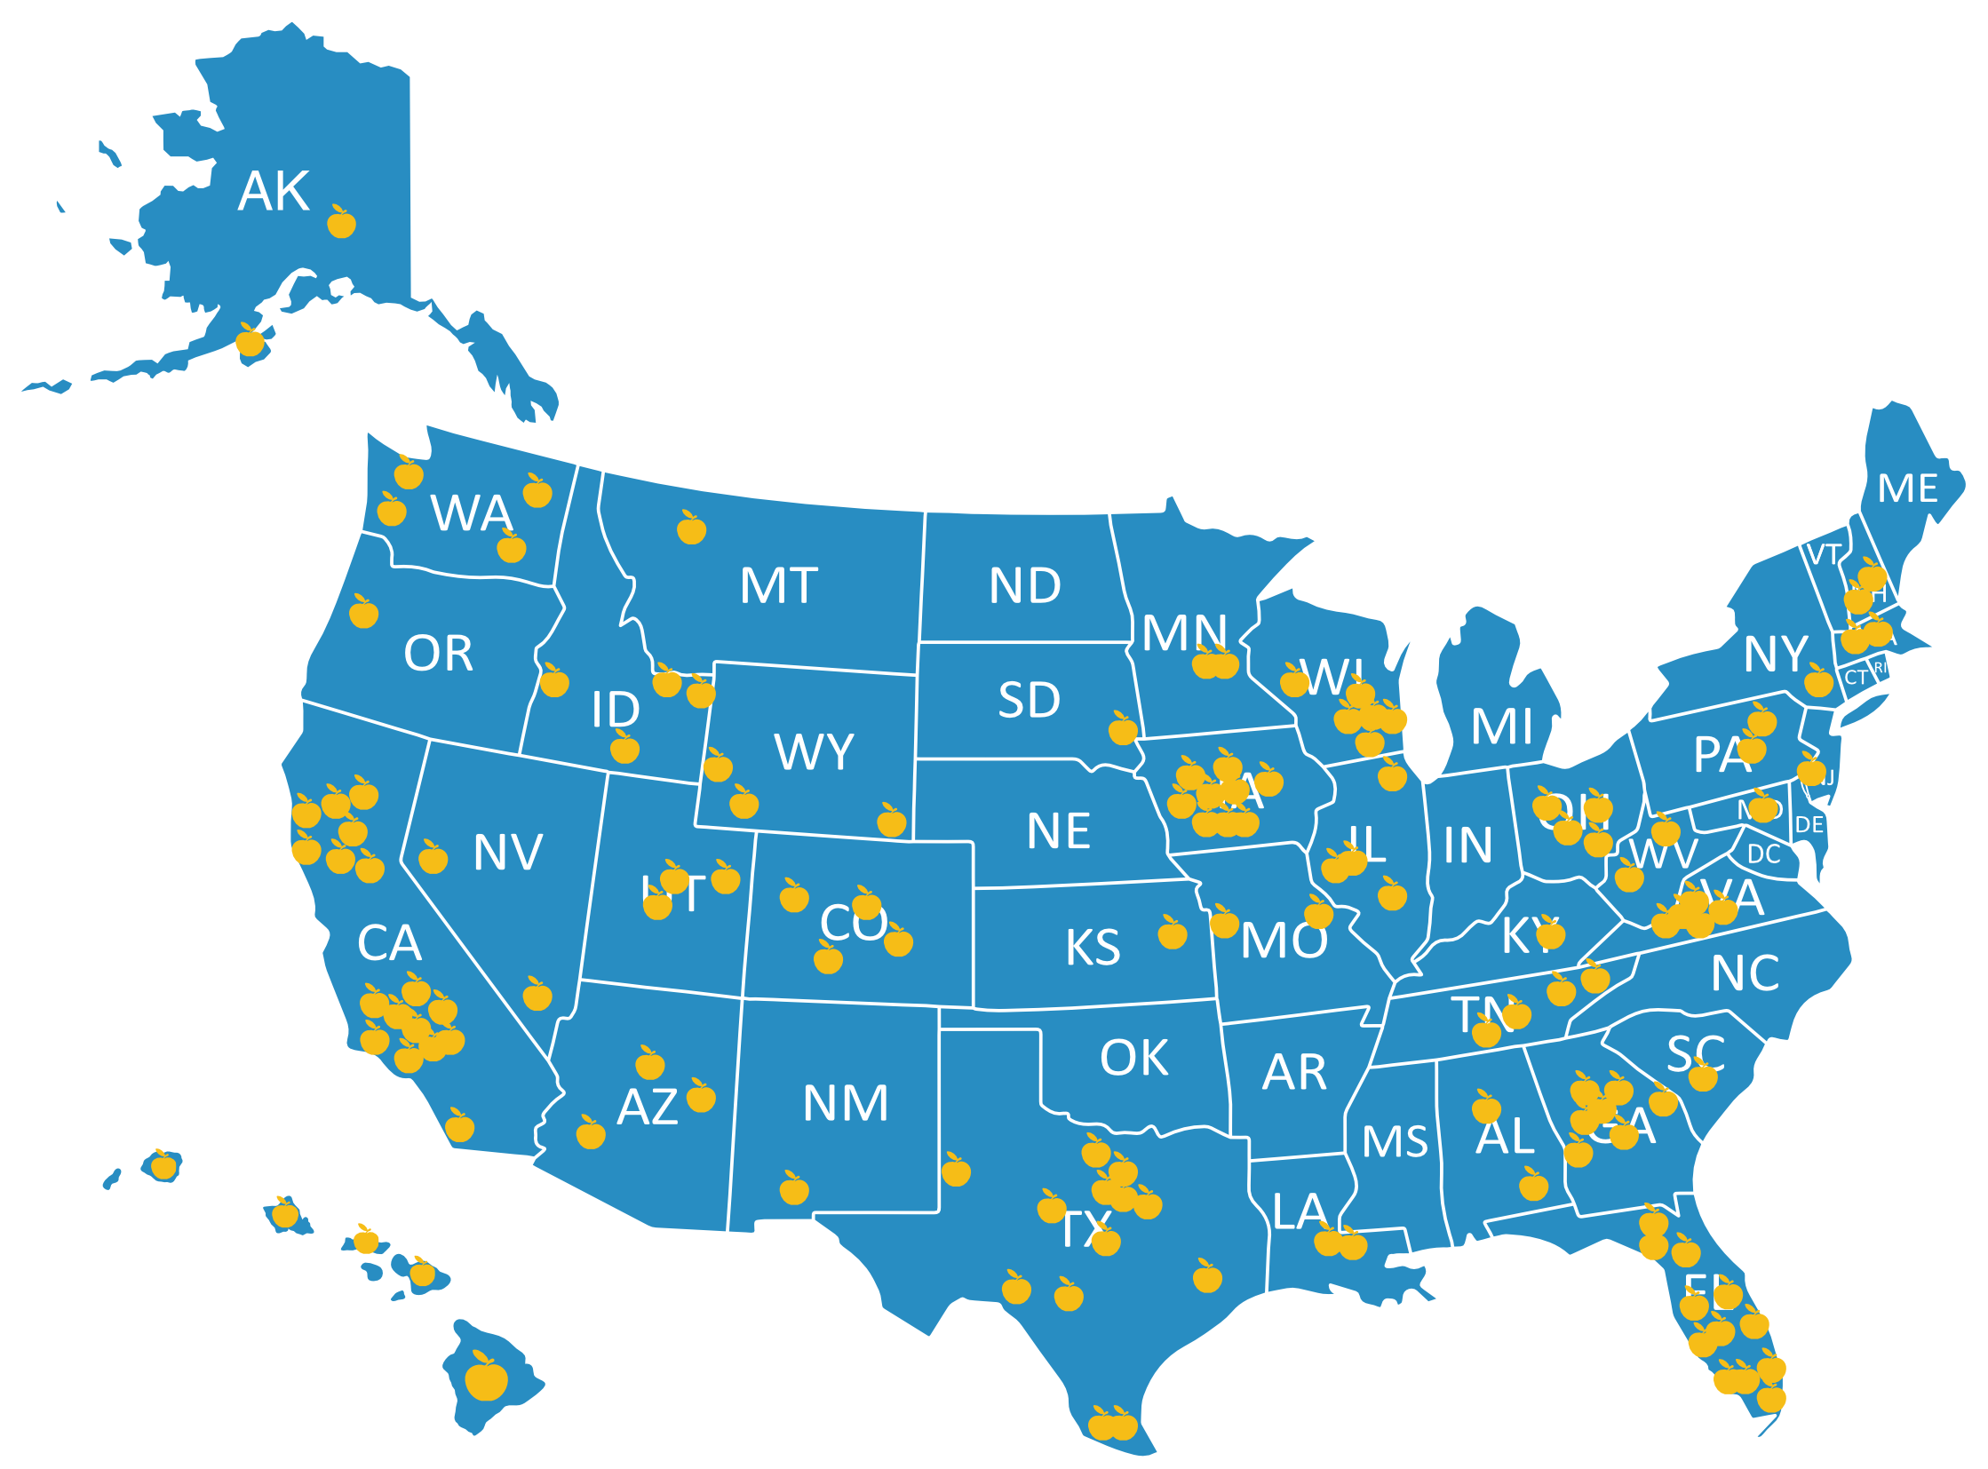

Facebook.com/stedi.org
LinkedIn.com/stedi.org

Slide 20
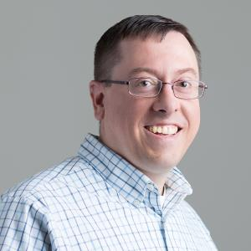
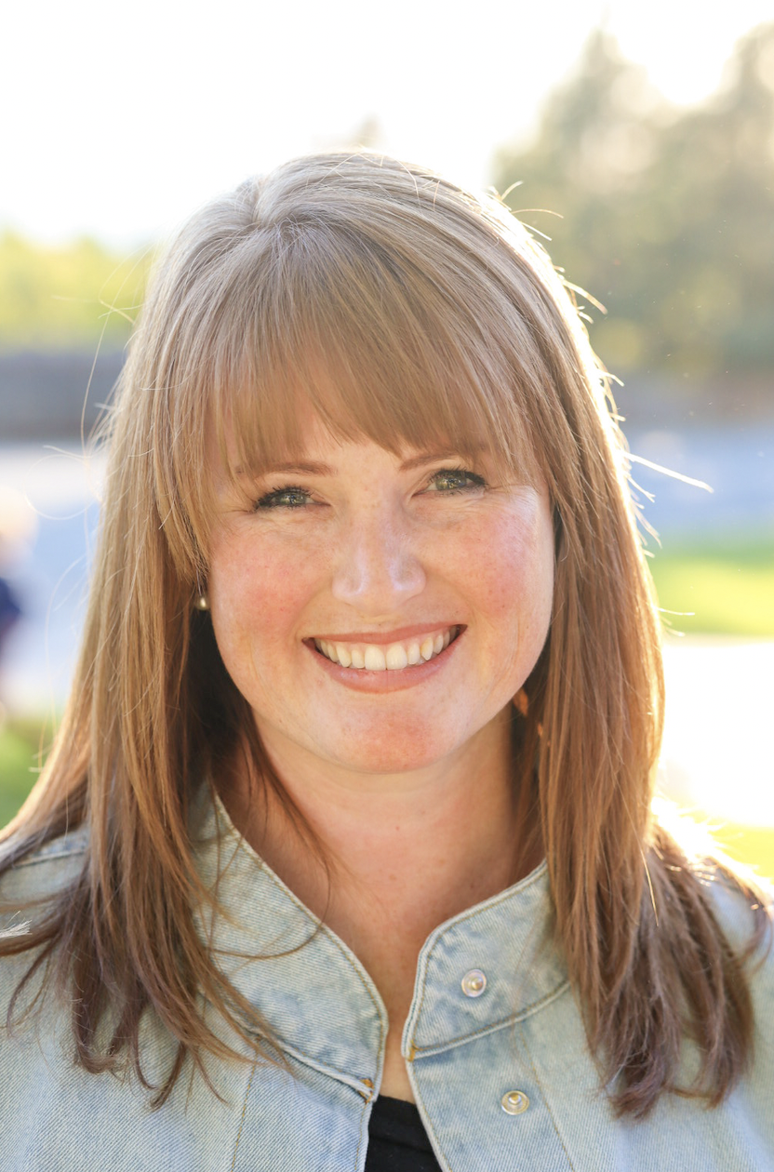
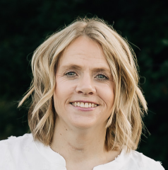
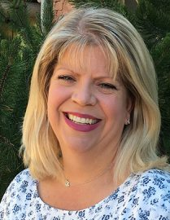
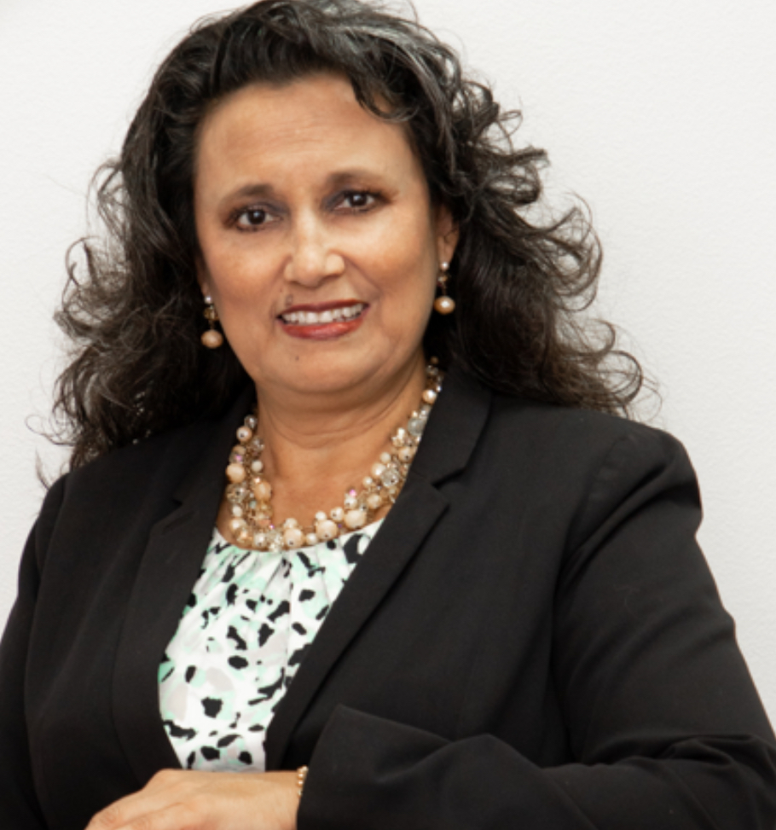
Josh@stedi.org
Jessica@stedi.org
Sheena@stedi.org
Kelley@stedi.org
Melissa@stedi.org

Slide 21


Slide 22
STEDI Ready Courses
STEDI Ready Playbook
Preparing for a STEDI Ready Year
STEDI Ready Data Analytics
STEDI Ready Recruiting Toolkit
STEDI Ready Training Toolkit
STEDI Ready Retention Toolkit

Slide 23

Education is not the filling of a pail, but a lighting of a fire.
Substitute teachers can light fires just as easily as other teachers but we need to create the environment for that to happen!

