Slide 1


April 11, 2025
Presented by
Melissa Aguero Ramirez
HR Consultant & Talent Development Director

Slide 2


Slide 3

56% of SubManagers have 1-3 years of experience working with substitute teachers
44% of districts conducted BTS trainings
76% of districts utilize Red Rover or “other” system
63% of districts employ 101-500 substitute teachers

Slide 4
83% of districts interview substitute teachers prior to hiring them
Job offers are usually made via email or application software
Most substitute teachers work 7 hours per day
Substitute teacher campus contacts do not get paid extra for these duties

Slide 5
90% of districts provide professional development to their instructional aides
50% - 75% of substitutes teachers are degreed but not teacher certified at majority of districts
80% of districts hire substitute teachers year round

Slide 6
Substitute Teacher Appreciation
Training
Substitute teacher of the month
Shout outs in newsletter
Celebrate national substitute teacher day
Lunch tickets
Words of appreciation
Substitute teacher of the year
Bonus for working more than 70 hours
Incentive pay for working Mondays and Fridays
End of year incentive
Substitute teacher appreciation at end of the year

Slide 7
85% of respondents said that Principals/Asst. Principals visit substitute teacher classrooms
100% of respondents stated that teachers are required to leave lesson plans
92% of districts do NOT have a SubTaskForce
90% of districts do NOT evaluate substitute teachers

Slide 8
April Checklist
Conduct interviews and make job offers (as needed)
Onboard new hires (as needed)
Ensure compliance with ACA requirements
Conduct campus check ins
Review fill rates
Substitute teacher evaluations

Slide 9
May Checklist
STEDI Surveys
Letter of Reasonable Assurance
Notify substitute teachers of continued employment for next school year
confirm continued employment interest
Initiate planning for Back to School (BTS) trainings (site, date/times based on instructional calendar, etc.)
Order ID badges, substitute teacher related items to replenish current school year use
Review fill rates
Ensure compliance with ACA requirements

Slide 10

Letter of reasonable assurance

Slide 11



End of Year Surveys
Substitute Teacher
Permanent Teachers
https://www.surveymonkey.com/r/STEDI-SubSurvey
https://www.surveymonkey.com/r/Fill-RateTeacher
School Staff
Principals
https://www.surveymonkey.com/r/Fill-RateStaff
https://www.surveymonkey.com/r/Fill-RatePrincipal

Slide 12
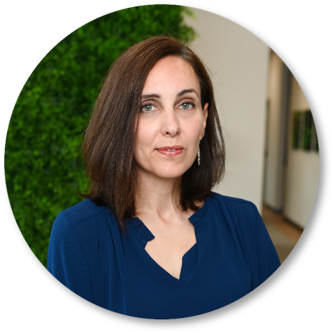
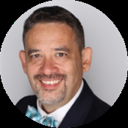

Leveraging Your Organization’s Unique Value to Attract and Keep Substitutes
Stephen Fujii
Vice President of Customer Experience
Dr. Kate Heynoski
Co-Founder / Chief

Slide 13
Schedule
August 28, 2024 (Wednesday) February 12, 2025 (Wednesday)
September 20, 2024 (Friday) March 11, 2025 **
October 22, 2024 (Tuesday) April 11, 2025 (Friday)
November 19, 2024 (Tuesday) May 14, 2025 (Wednesday)
December 4, 2024** UPDATE June 25, 2025 (Wednesday) UPDATE
January 16, 2025 (Thursday) July 17, 2025 (Thursday)

Slide 14
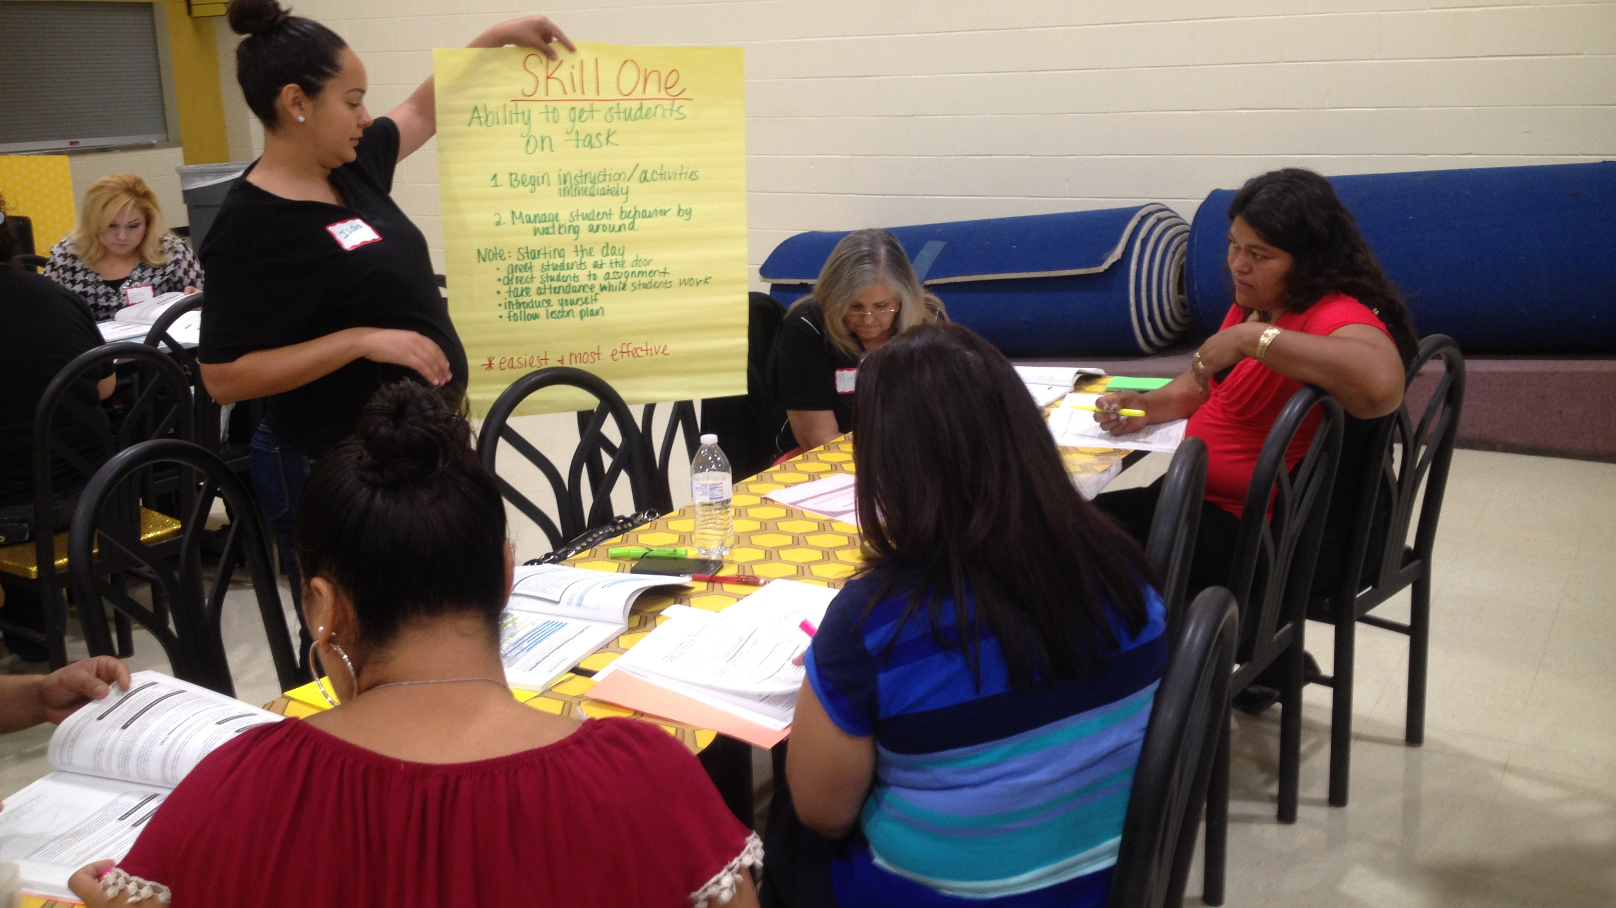
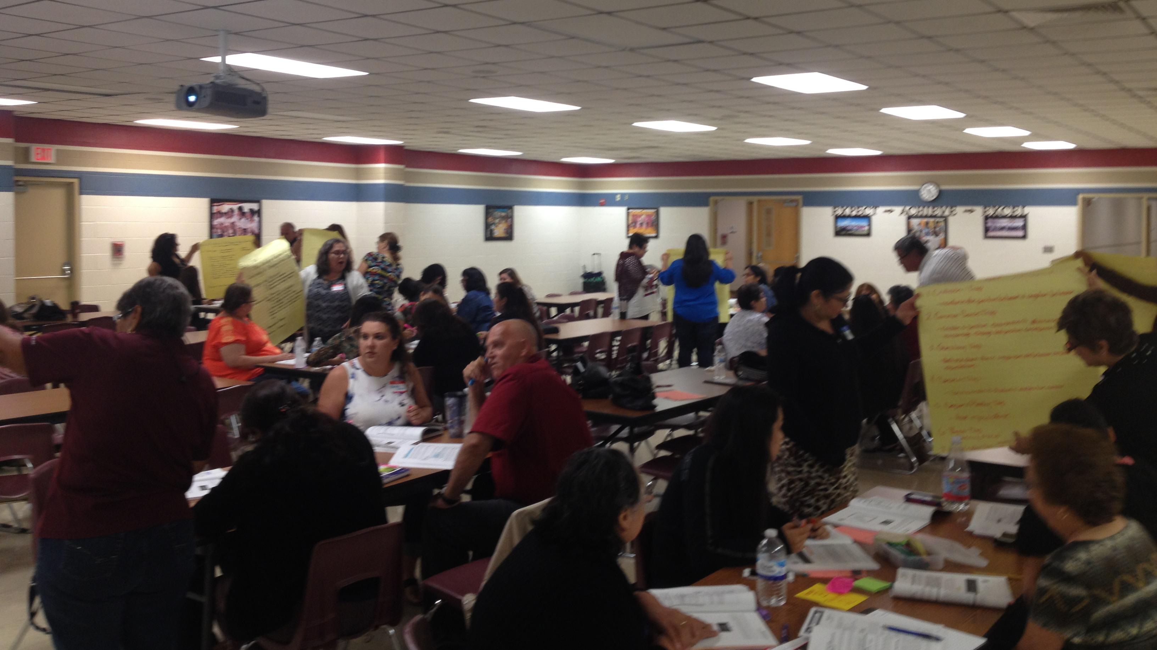
STEDI support
Online training
  Substitute teachers
  Classroom management for Teachers
  Special education settings
On site training
  Substitute teachers
  Instructional aides

Slide 15

Substitute Teacher Appreciation Week
May 5-9, 2025
https://www.stedi.org/giveaway/

Slide 16
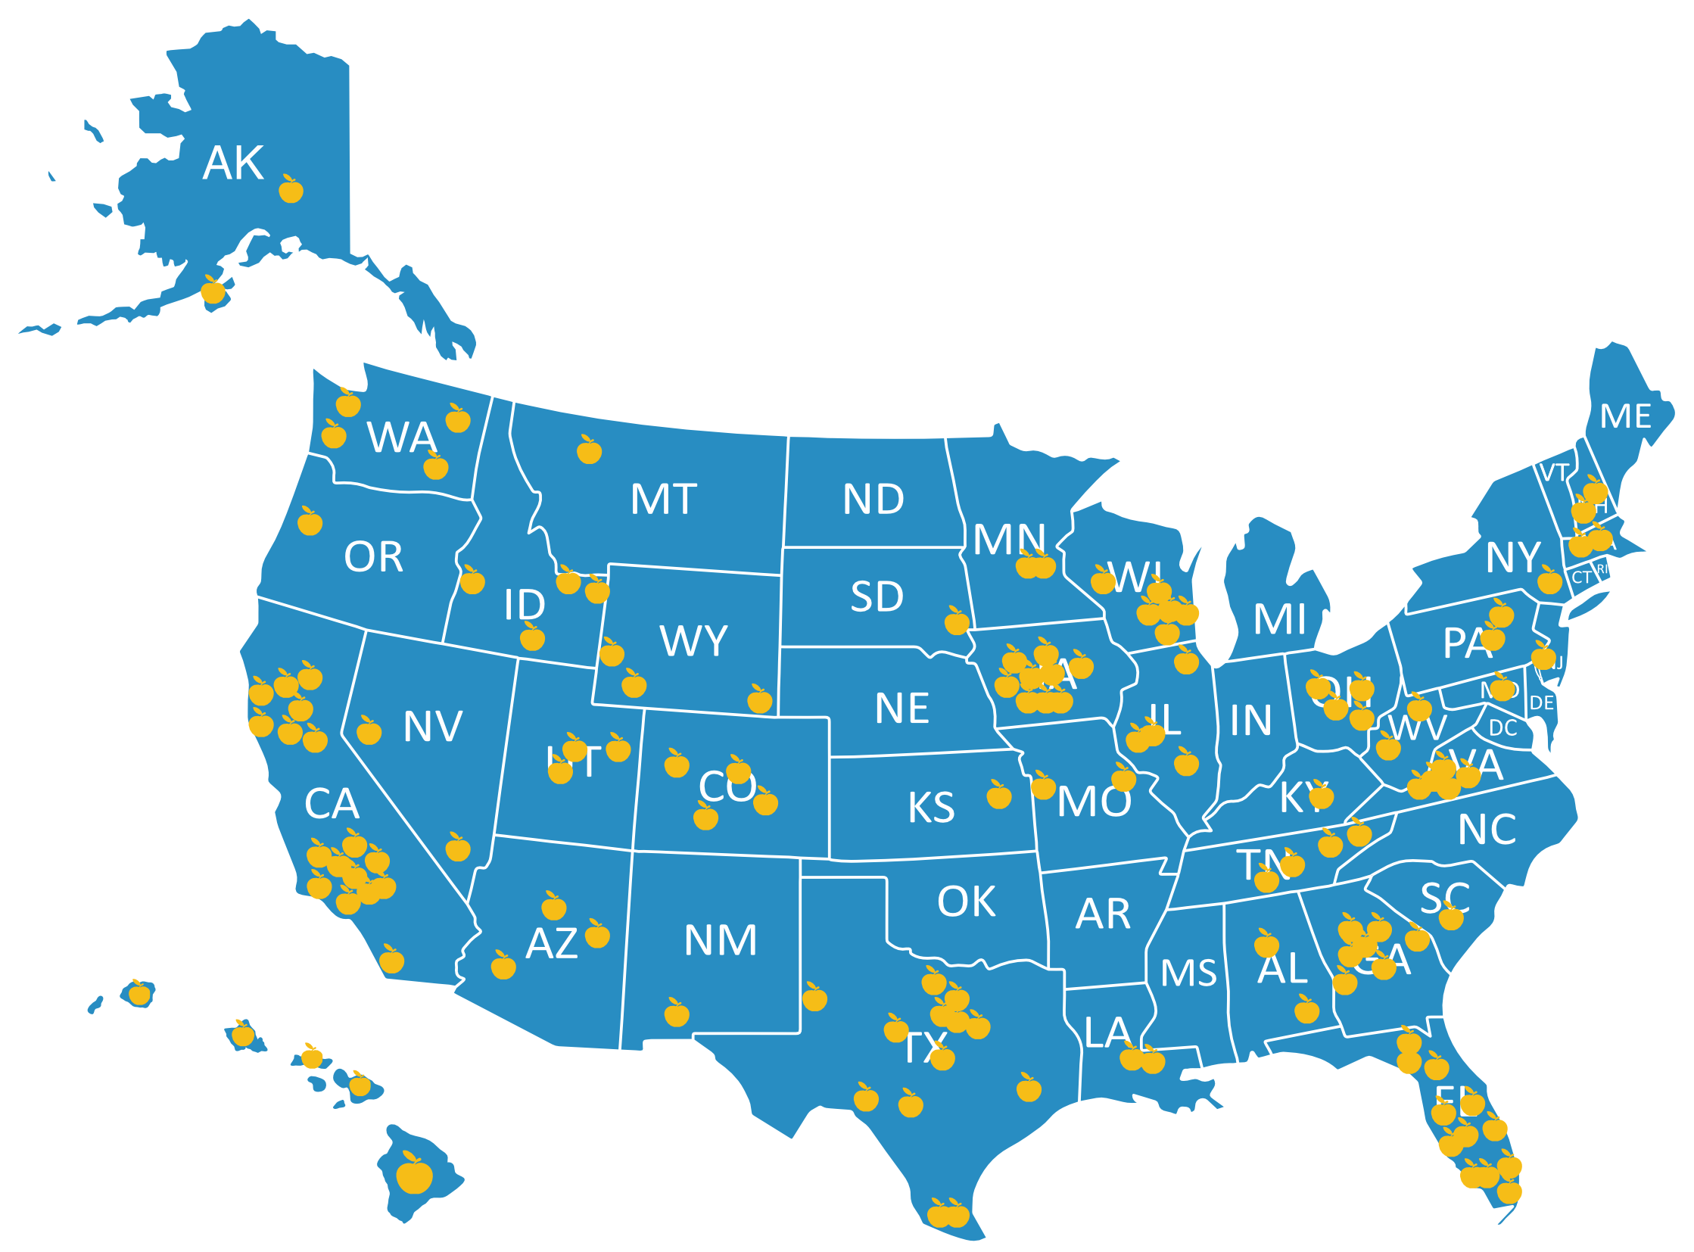

Facebook.com/stedi.org
LinkedIn.com/stedi.org

Slide 17
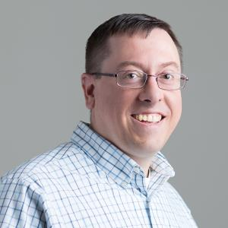
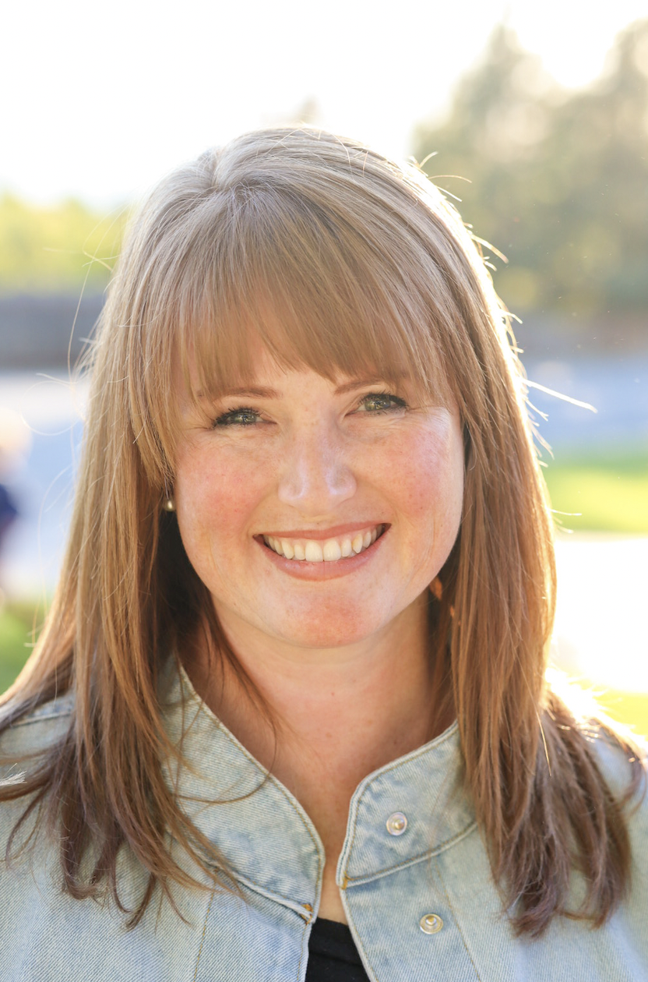
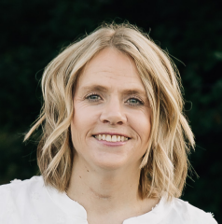
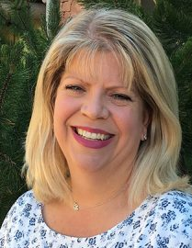
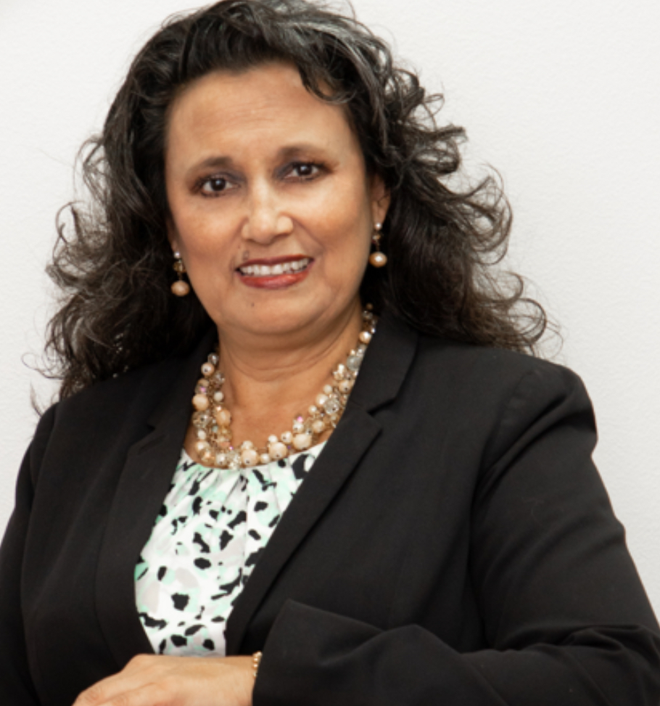
Josh@stedi.org
Jessica@stedi.org
Sheena@stedi.org
Kelley@stedi.org
Melissa@stedi.org

Slide 18

Every storm runs out of rain
Try to be a rainbow in someone’s cloud Maya Angelou

