Slide 1


November 19, 2024
Presented by
Melissa Aguero Ramirez
HR Consultant & Talent Development Director

Slide 2


https://www.instagram.com/reel/DA-TfIKMXqo/?igsh=M2U4a2ZvbHVmMWll

Slide 3
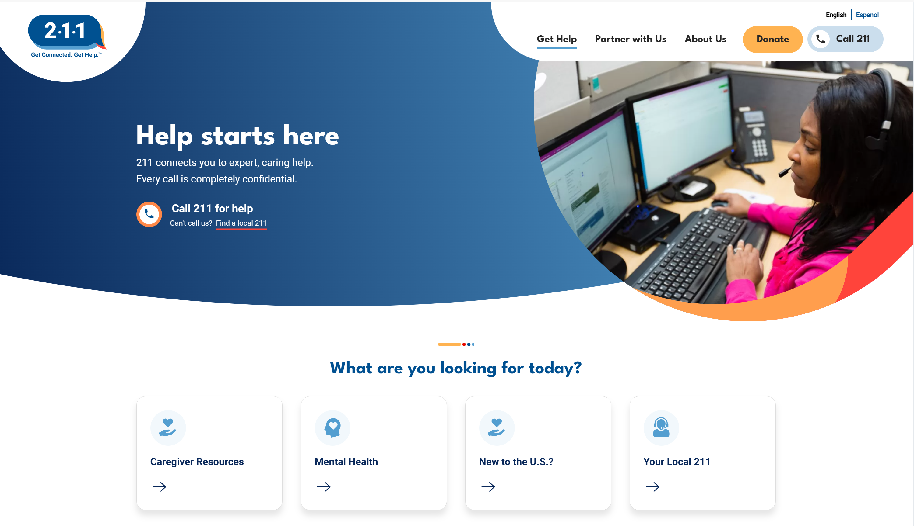
https://www.211.org/

Slide 4
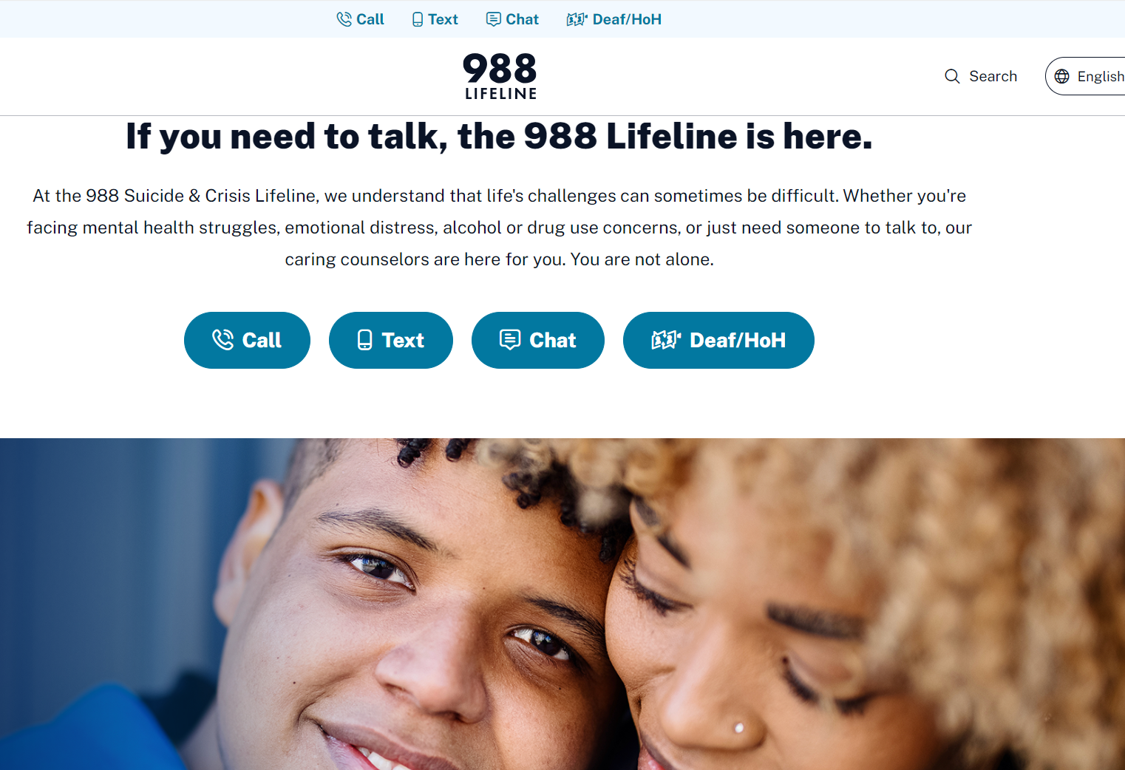
https://988lifeline.org/

Slide 5

56% of SubManagers have 1-3 years of experience working with substitute teachers
44% of districts conducted BTS trainings
76% of districts utilize Red Rover or “other” system
63% of districts employ 101-500 substitute teachers

Slide 6
83% of districts interview substitute teachers prior to hiring them
Job offers are usually made via email or application software
Most substitute teachers work 7 hours per day
Substitute teacher campus contacts do not get paid extra for these duties

Slide 7
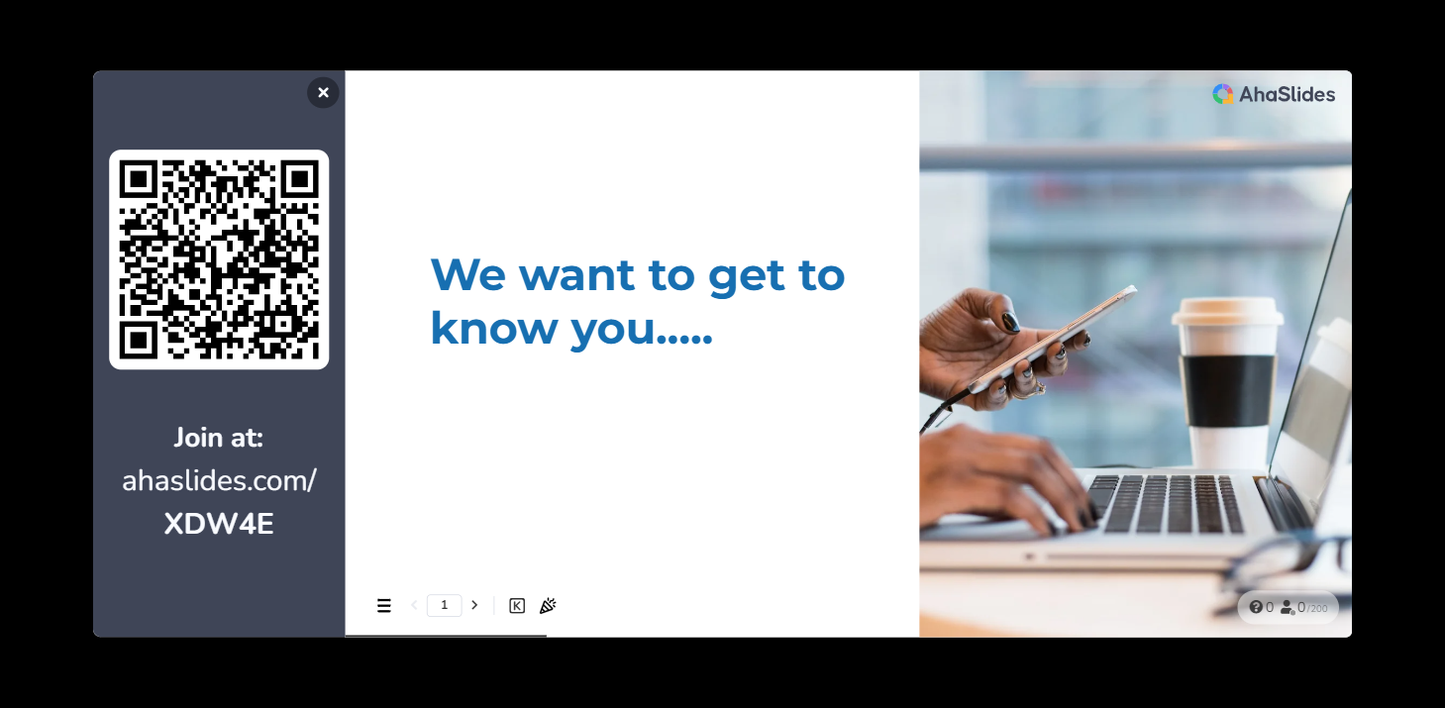

Slide 8


Slide 9
FMLA
Designed to provide employees with:
Job protection
Continued health benefits
UNPAID within 1 year*
Reasons / qualifying events:
Health (employee’s or spouse, parent, or child)
Birth/care for newborn/adoption/foster care
Qualifying exigency – military family member called to duty
Care for military family member who gets injured (26 weeks)
Eligibility requirements:
Employed for at least 12 months
Worked 1250 hours in the 12 months preceding request
Employed at a site with 50 or more employees
26 weeks for military family member who gets injured
12 weeks for health, birth or qualifying exigency

Slide 10
FMLA – Qualifying Exigency
Short-notice deployment - up to seven days
Military events and related activities
Childcare and school activities
Financial and legal arrangements
Non-medical counseling
Care of the military member’s parent
Rest and recuperation - up to fifteen days
Post-deployment activities - 90-day period
Additional activities by agreement

Slide 11

FMLA – Military Caregiver
Allows eligible employee to take 26 workweeks within 12 month period to care for service member who is injured / ill
Definition of next of kin
Blood relative w/court decree or legal custody
Blood relative designated as caregiver by employee
Brother/sister
Grandparent
Aunt/uncle
First cousin

Slide 12

District Responsibilities
Communicate with employee documents that need to be finalized within appropriate timeline
1
Process absences as requested
2
Contribute towards benefits as if prior to FMLA
3
Return to similar position upon reinstatement
4

Slide 13
Employee Responsbilities
Notify appropriate office of need for leave
Submit documentation to qualify for FML
Inform supervisor of the type(s) of leave to utilize while absent (optional)
Acquire documentation BEFORE release to return to work

Slide 14
FMLA related forms
Notice of eligibility
Certifications
Certification of health care provider – employee
Certification of health care provider – family
Certification for serious injury/illness – veteran
Certification for serious injury/illness – current servicemember
Certification of qualifying exigency
Designation notice

Slide 15
Other Related documents
Absence from Duty report
Employee informs district reason for absence
Employee informs district what type of leave to use
Worker’s Comp Offset form

Slide 16
FMLA timelines
Must notify employee of eligibility within 5 BUSINESS days in writing & include Notice of Rights & Responsibilities
Must notify employee of DESIGNATION within 5 business days
Retroactive determination

Slide 17
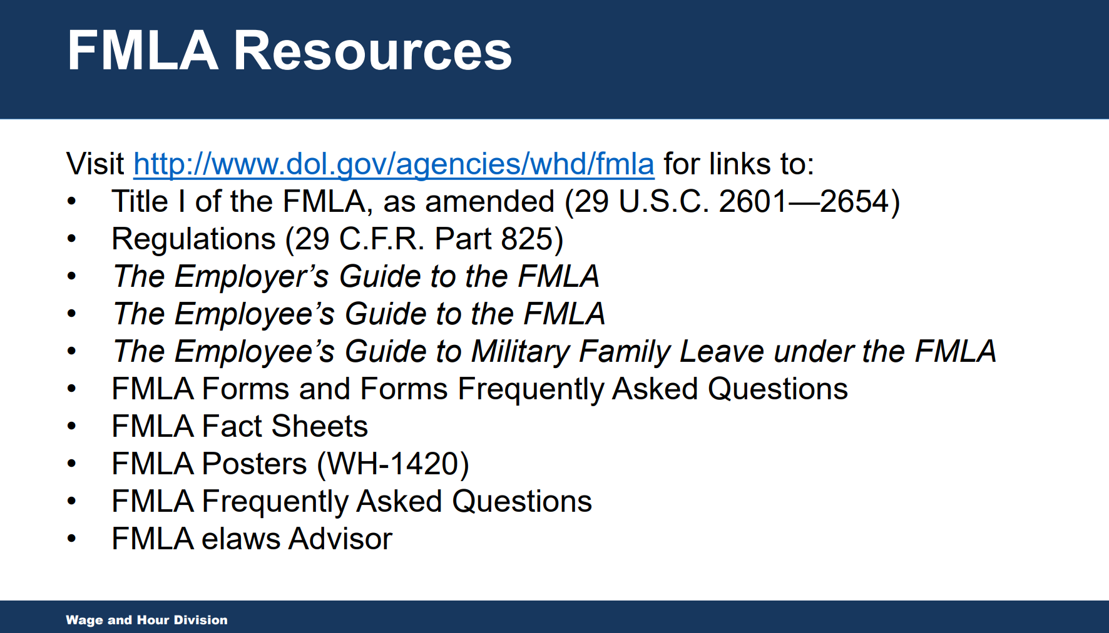
http://www.dol.gov/agencies/whd/fmla

Slide 18

Questions on FMLA?
  Next month:
  ADA

Slide 19
November Checklist
Conduct interviews and make job offers (as needed)
Onboard new hires (as needed)
Ensure compliance with ACA requirements
Conduct campus check ins
Review fill rates

Slide 20
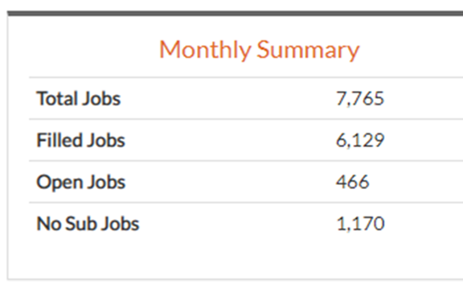
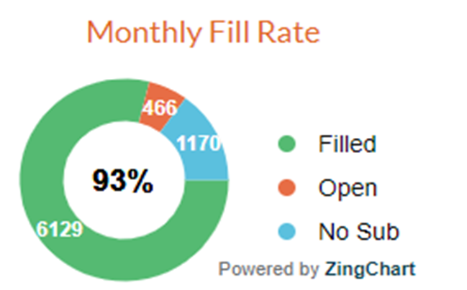
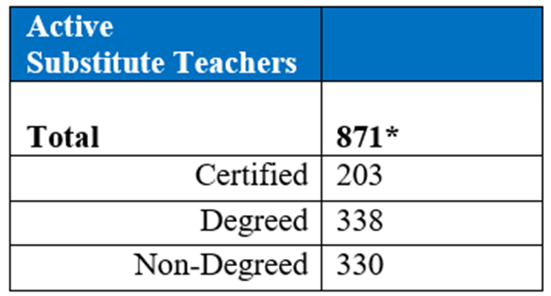

Slide 21
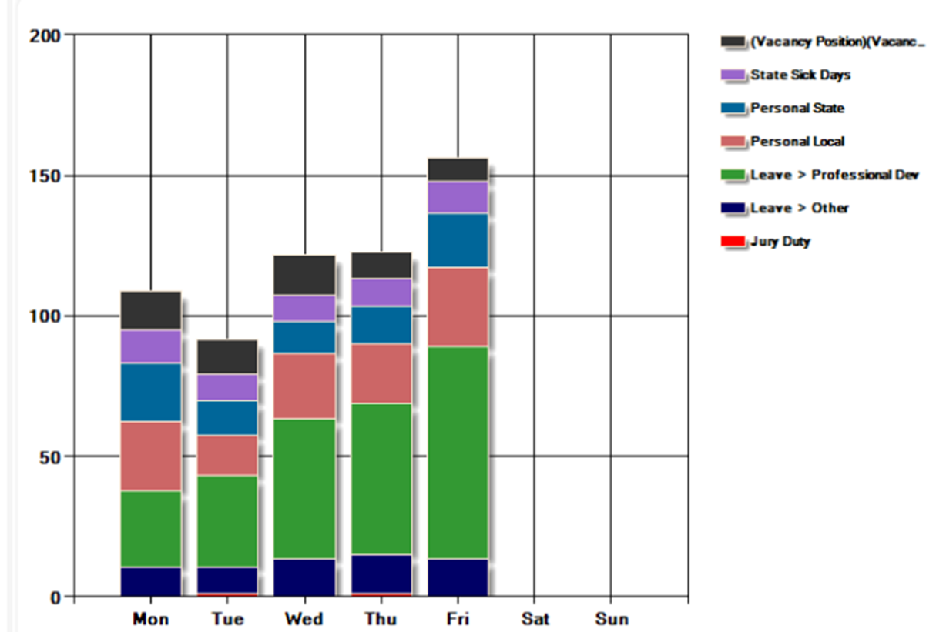
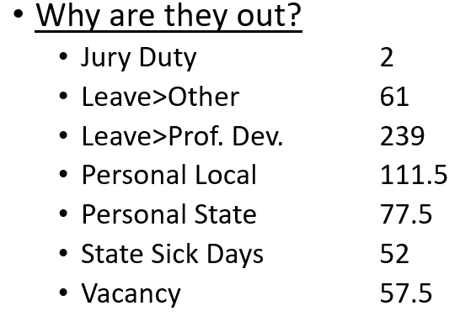

Slide 22
December Checklist
Register for Spring college/university job fairs
Ensure compliance with ACA requirements
Conduct campus check ins
Review fill rates

Slide 23
January Checklist
Conduct interviews and make job offers
Onboard new hires
Ensure compliance with ACA requirements
Mid Year Check In - Meet with campus substitute managers
* Substitute teacher performance
* General feedback
Mid Year Check In - Meet with campus administration
* Fill rates
* Teacher absence data
* General feedback
Review fill rates

Slide 24
Schedule
August 28, 2024 (Wednesday) February 12, 2025 (Wednesday)
September 20, 2024 (Friday) March 11, 2025 **
October 22, 2024 (Tuesday) April 11, 2025 (Friday)
November 19, 2024 (Tuesday) May 14, 2025 (Wednesday)
December 4, 2024** UPDATE June SUBSOLUTIONS CONFERENCE
January 16, 2025 (Thursday) July 17, 2025 (Thursday)

Slide 25

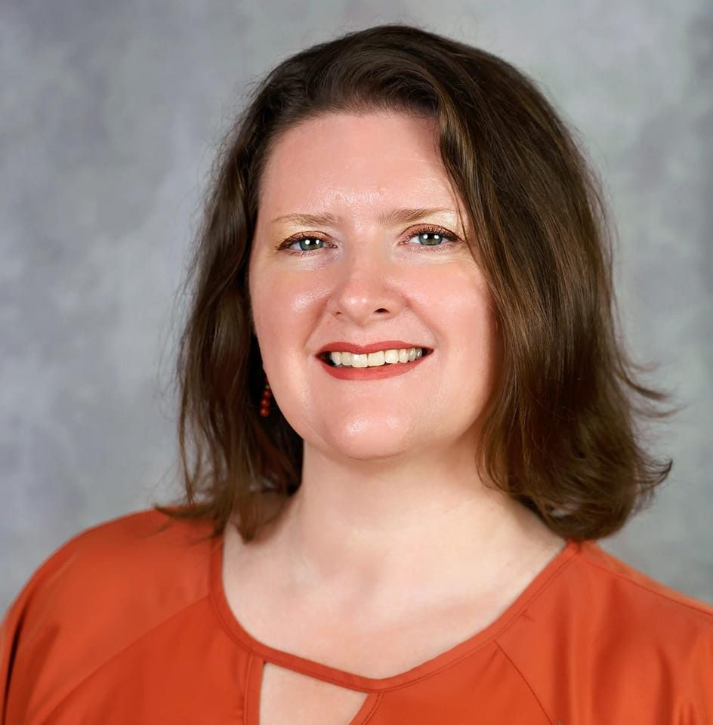



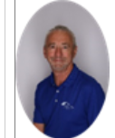
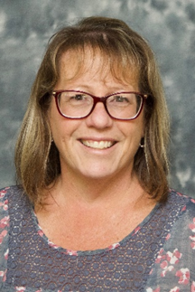
Coming in December: Human Resources Panel
Christi Hetrick, Substitute Supervisor
Prince William County Schools
Mellissa J. Braham, APR, Associate Director
National School Public Relations Association
Adelaida Castillo, Teacher Leadership Development, Teach for America
Matt Vance, Co-Founder and CEO
Mobrium
Loren Cross, OSTS Payroll Manager
Educational Service Center of Northeast Ohio
Steve Rogaski, Exec. Director – HR & Pupil Services, ESC of Northeast Ohio
Cari Wiley, OSTS Manager
Educational Service Center of Northeast Ohio

Slide 26
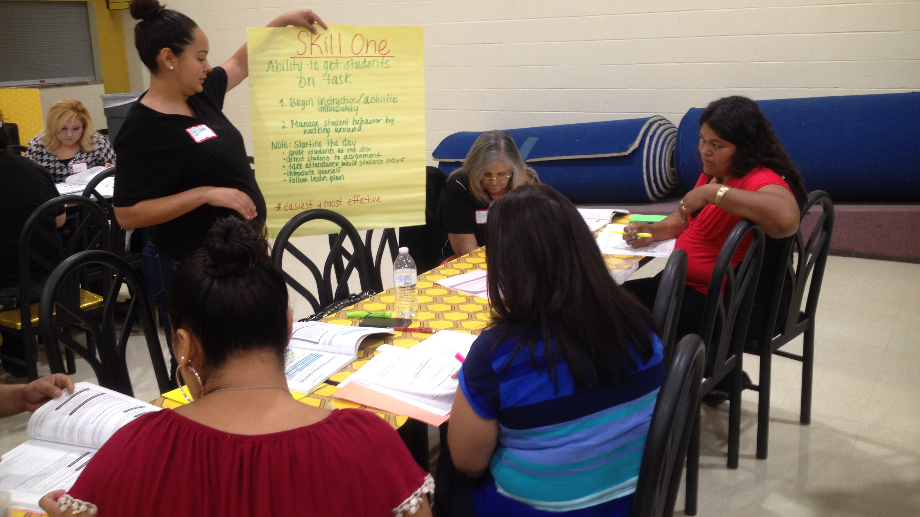
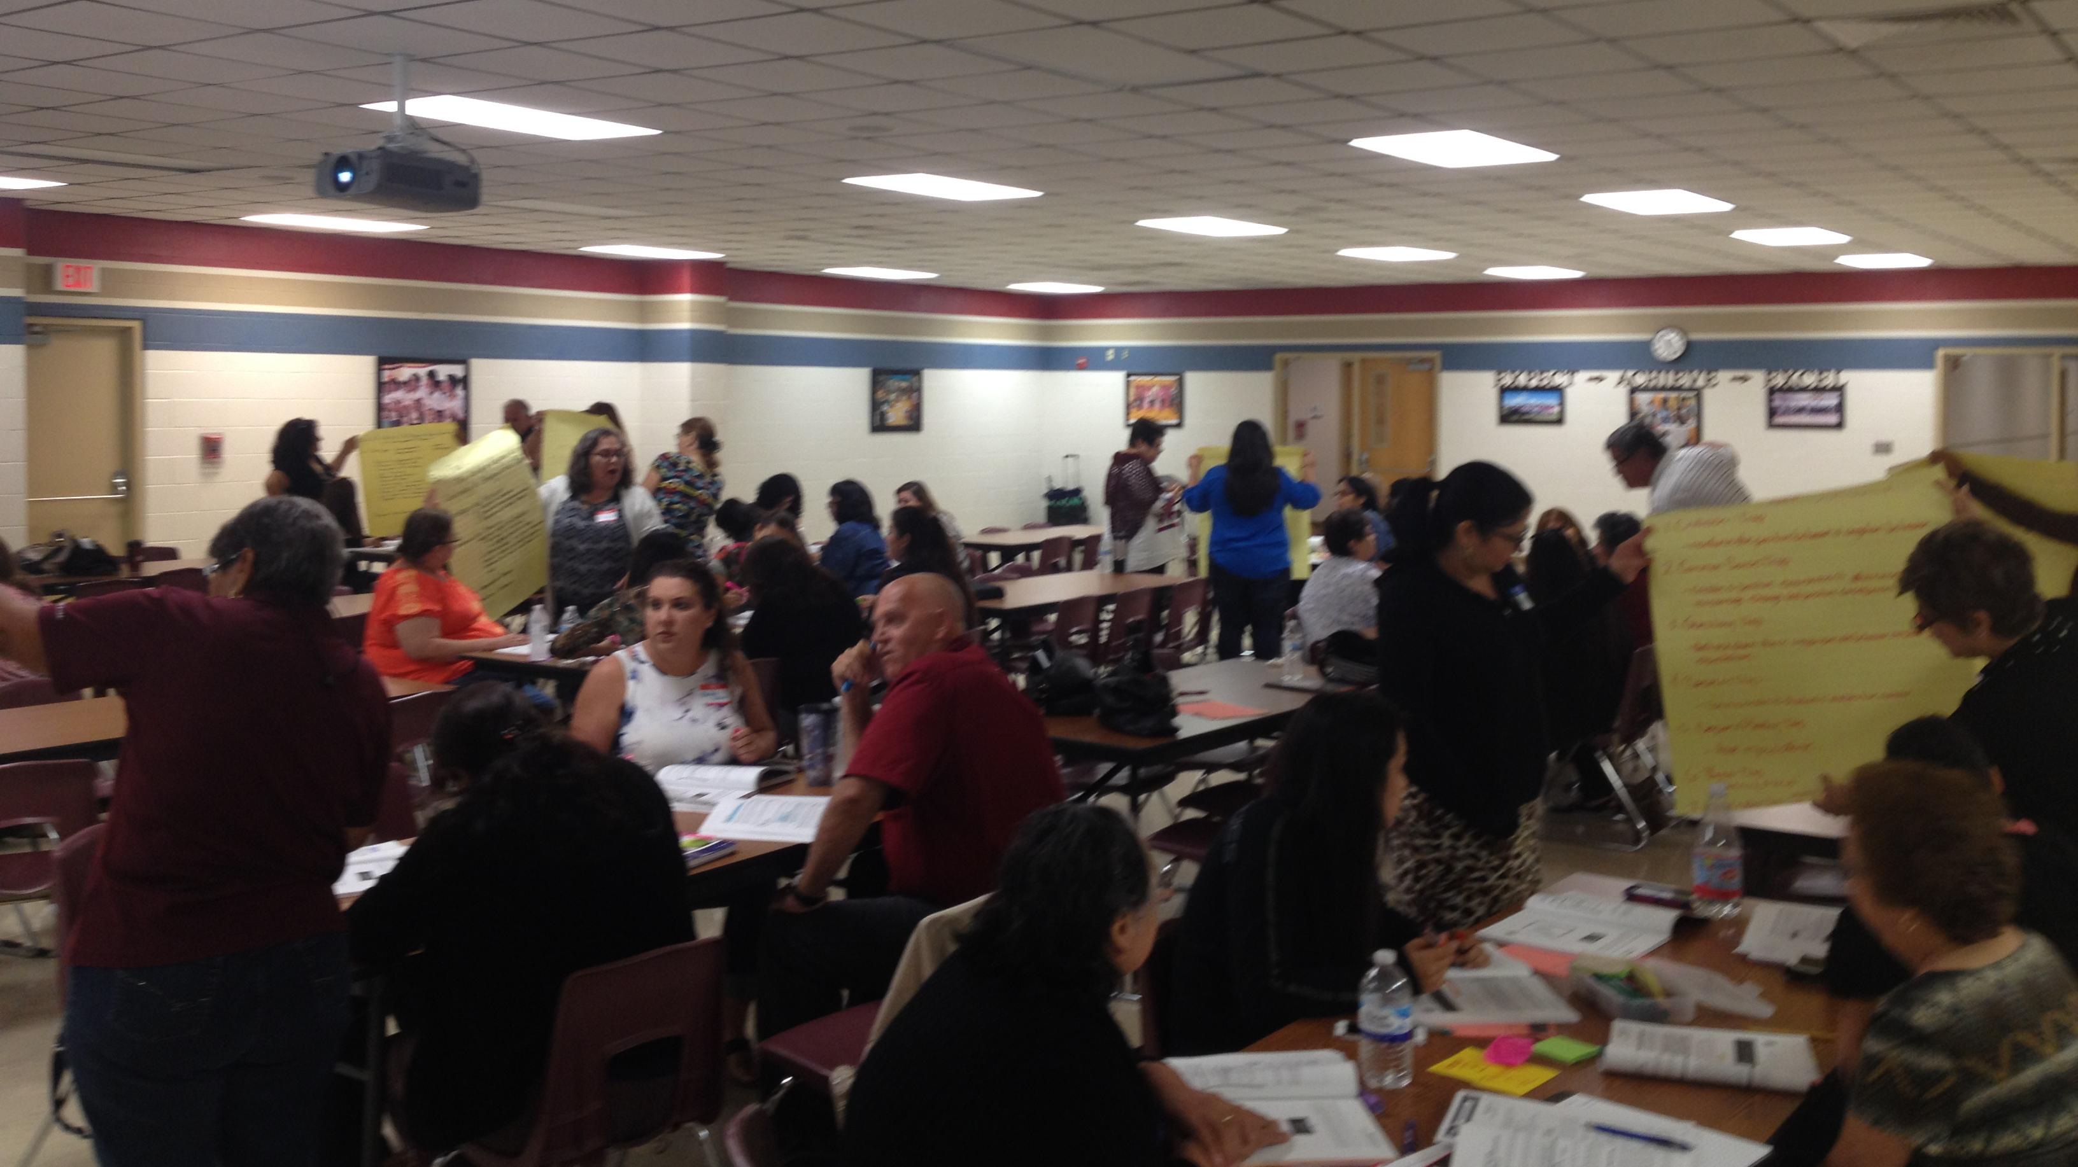
STEDI support
Online training
  Substitute teachers
  Classroom management for Teachers
On site training
  Substitute teachers
  Instructional aides

Slide 27

https://www.stedi.org/subsolutions/

Slide 28
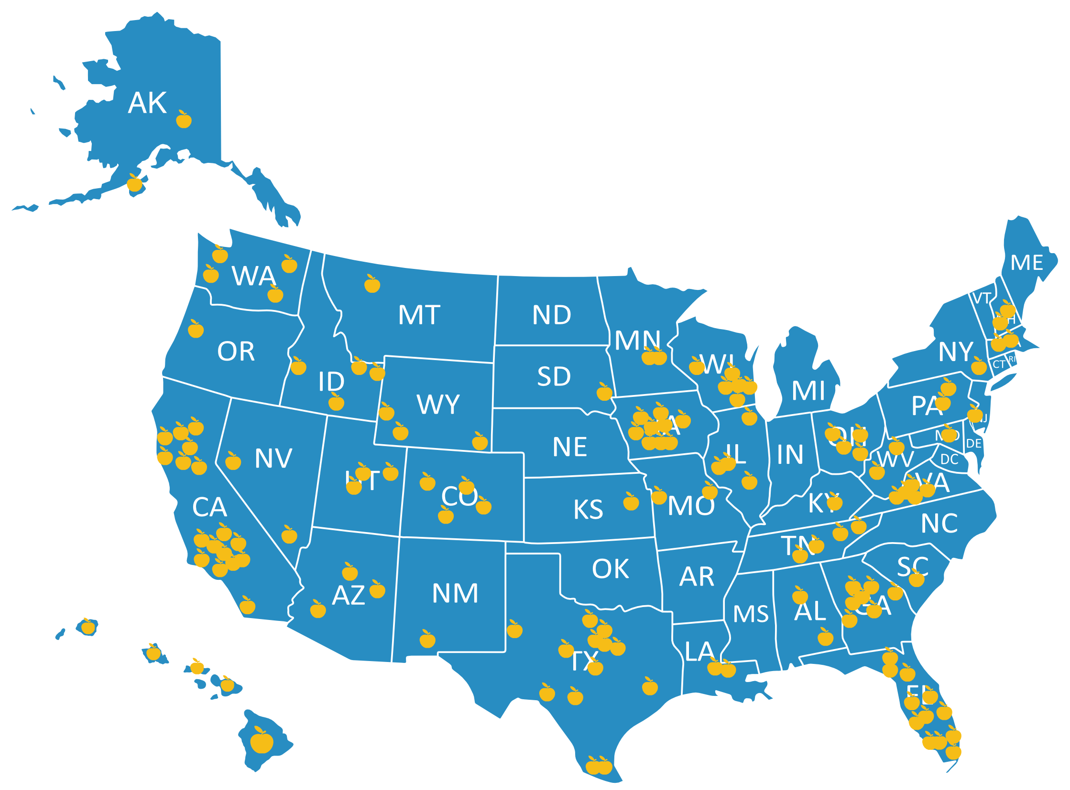

Facebook.com/stedi.org
LinkedIn.com/stedi.org

Slide 29

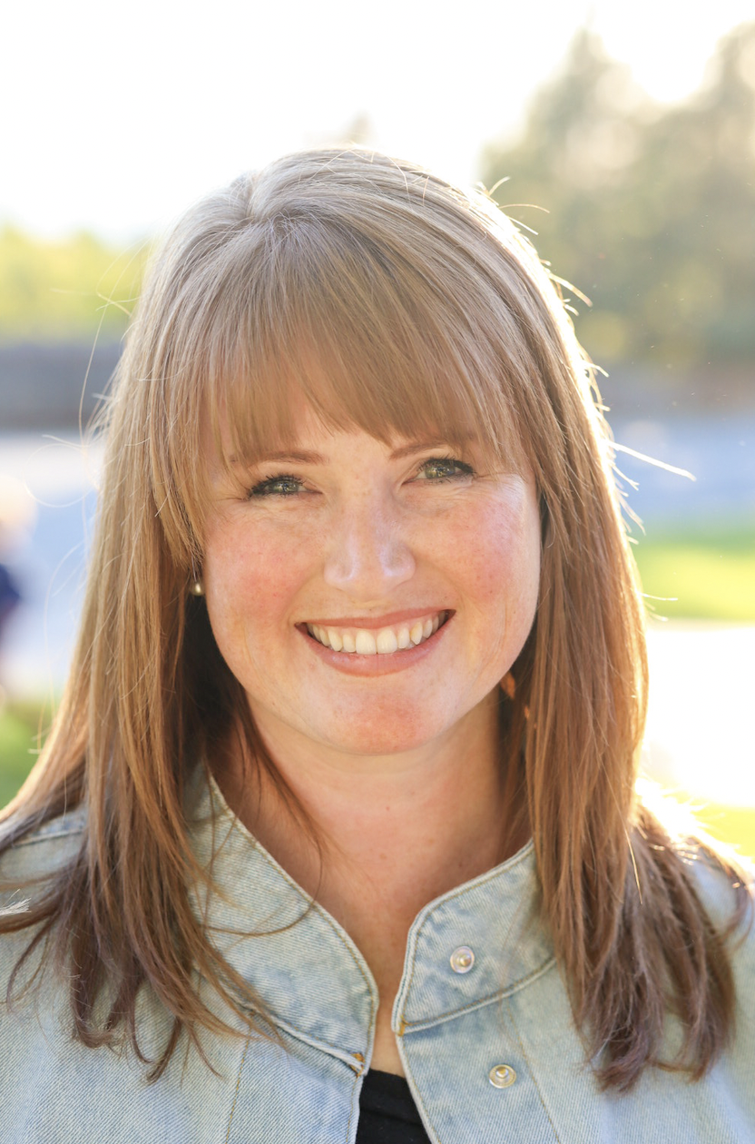

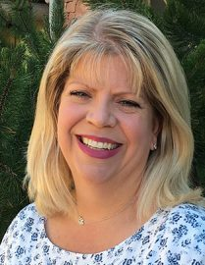
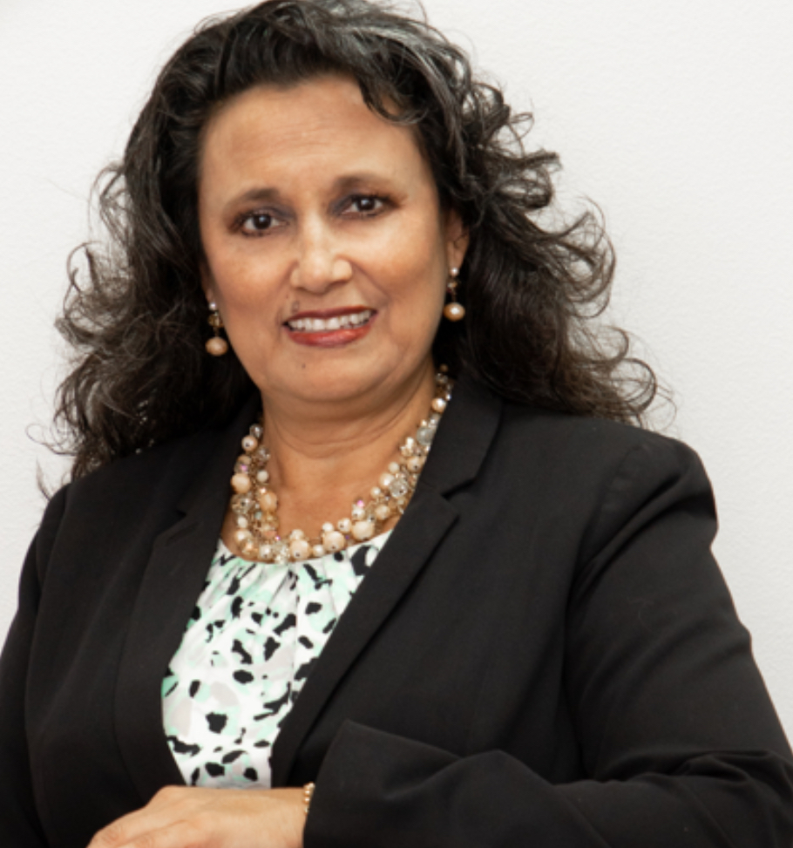
Josh@stedi.org
Jessica@stedi.org
Sheena@stedi.org
Kelley@stedi.org
Melissa@stedi.org

Slide 30


