Slide 1


October 22, 2024
Presented by
Melissa Aguero Ramirez
HR Consultant & Talent Development Director

Slide 2


Slide 3

56% of SubManagers have 1-3 years of experience working with substitute teachers
44% of districts conducted BTS trainings
76% of districts utilize Red Rover or “other” system
63% of districts employ 101-500 substitute teachers

Slide 4
83% of districts interview substitute teachers prior to hiring them
Job offers are usually made via email or application software
Most substitute teachers work 7 hours per day
Substitute teacher campus contacts do not get paid extra for these duties

Slide 5


Slide 6
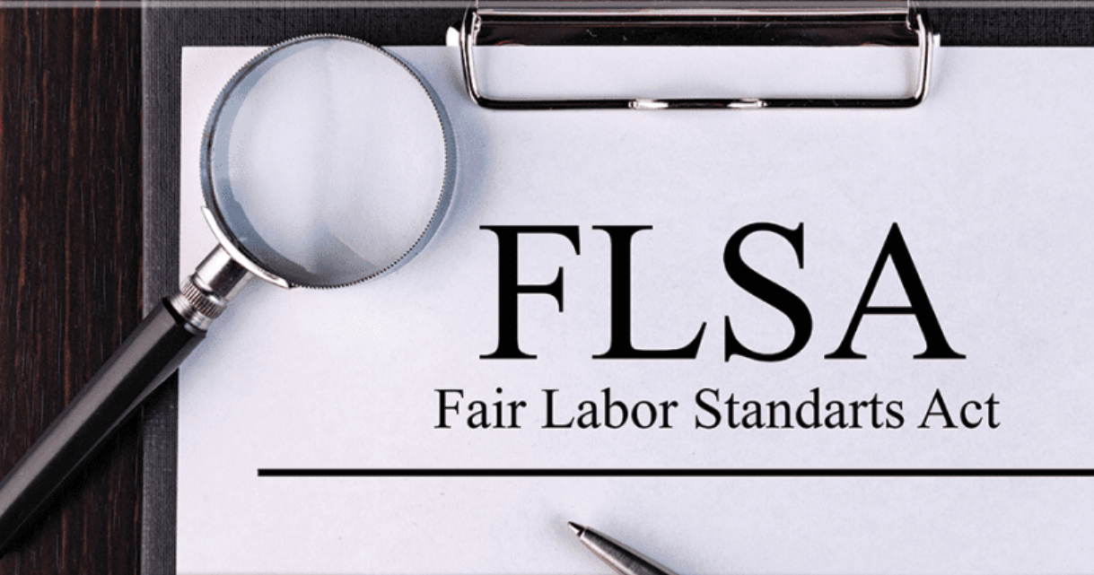

Slide 7
What is the FLSA?
Enacted 1938
US Department of Labor – Wage and Hour Division
What does it do?
  Minimum wage
  Overtime pay
    Identification of exempt/nonexempt and those not covered by law
  Equal pay
  Child labor standards
  Record keeping

Slide 8
FLSA Does NOT require
Premium pay for Saturdays, Sundays, or holidays
Time off, paid or otherwise, for holidays or vacations
Discharge notices or severance pay
Limits on number of hours of work for those 16 yrs+ as long as OT pay provisions are met
General meal or rest breaks, but does require unpaid breastfeeding breaks for nursing mothers

Slide 9
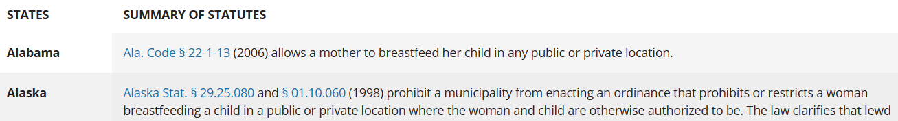
Breastfeeding requirements
Federal Law – Healthcare Reform Act and the PUMP Act
http://www.dol.gov/whd/nursingmothers/
  Reasonable break time
  Space requirements
  Up to 1 year after child’s birth
  FAQ at PUMP-education-faq.pdf (dol.gov)
State Law – Breastfeeding State Laws (ncsl.org)

Slide 10
Exempt vs. NonExempt
Determination for coverage purposes
  Exempt employees are NOT subject to:
    Minimum wage
    Overtime
    Timekeeping
Based on duties and responsibilities
Must be paid a salary of
  $844 per week (equivalent to a $43,888 annual salary) effective 7/1/24
  $1,128 per week (equivalent to a $58,656 annual salary) effective 1/1/25
5 exemption tests

Slide 11
Exempt or NonExempt? Courtesy TASB
Exempt employees get paid to get the job done
  Campus Principal
  HR Director
  Teacher (and Substitute teacher)
Nonexempt employees get paid for the time they work
  Secretary
  Clerk
  Instructional aide

Slide 12
What time is paid?
All time permitted or required to work
Includes:
  Required waiting time
  Required training time
  Additional duties
  Work from home
For determining OT, does NOT include:
  Paid leave benefits
  Personal or sick days
  Vacation

Slide 13
What time is NOT paid?
Volunteer*
  Services not similar to regular work
The De Minimis rule
  Less than 10 minutes
“rounding” start/end times
  To nearest 5 minutes, 6 minutes, or 15 minutes
  Must round up and down

Slide 14
Overtime Compensation (OT)
Workweek defined
Time and a half of regular hourly rate for any time over 40 hours
If works two jobs with two different rates, find weighted average hourly rate x 1.5

Slide 15
Compensatory Time (CT)
State and local governments
Time and a half of HOURS over 40
Employer must notify employee of this agreement BEFORE overtime worked
Max 240 hours before must be paid out
  District CAN set lower max (Texas sample: Board policy DEA Local)
Recommend use it asap
  District CAN require CT be used BEFORE any other leave (Texas sample: Board policy DEC Local)

Slide 16
Options
  CT and OT: compensation calculated AFTER an employee works more than 40 hours in one workweek
  Flex Time: time worked during the workweek BEFORE 40 hours reached
    schedule is modified so employee does not exceed 40 hours
    NO CT/OT accumulated

Slide 17
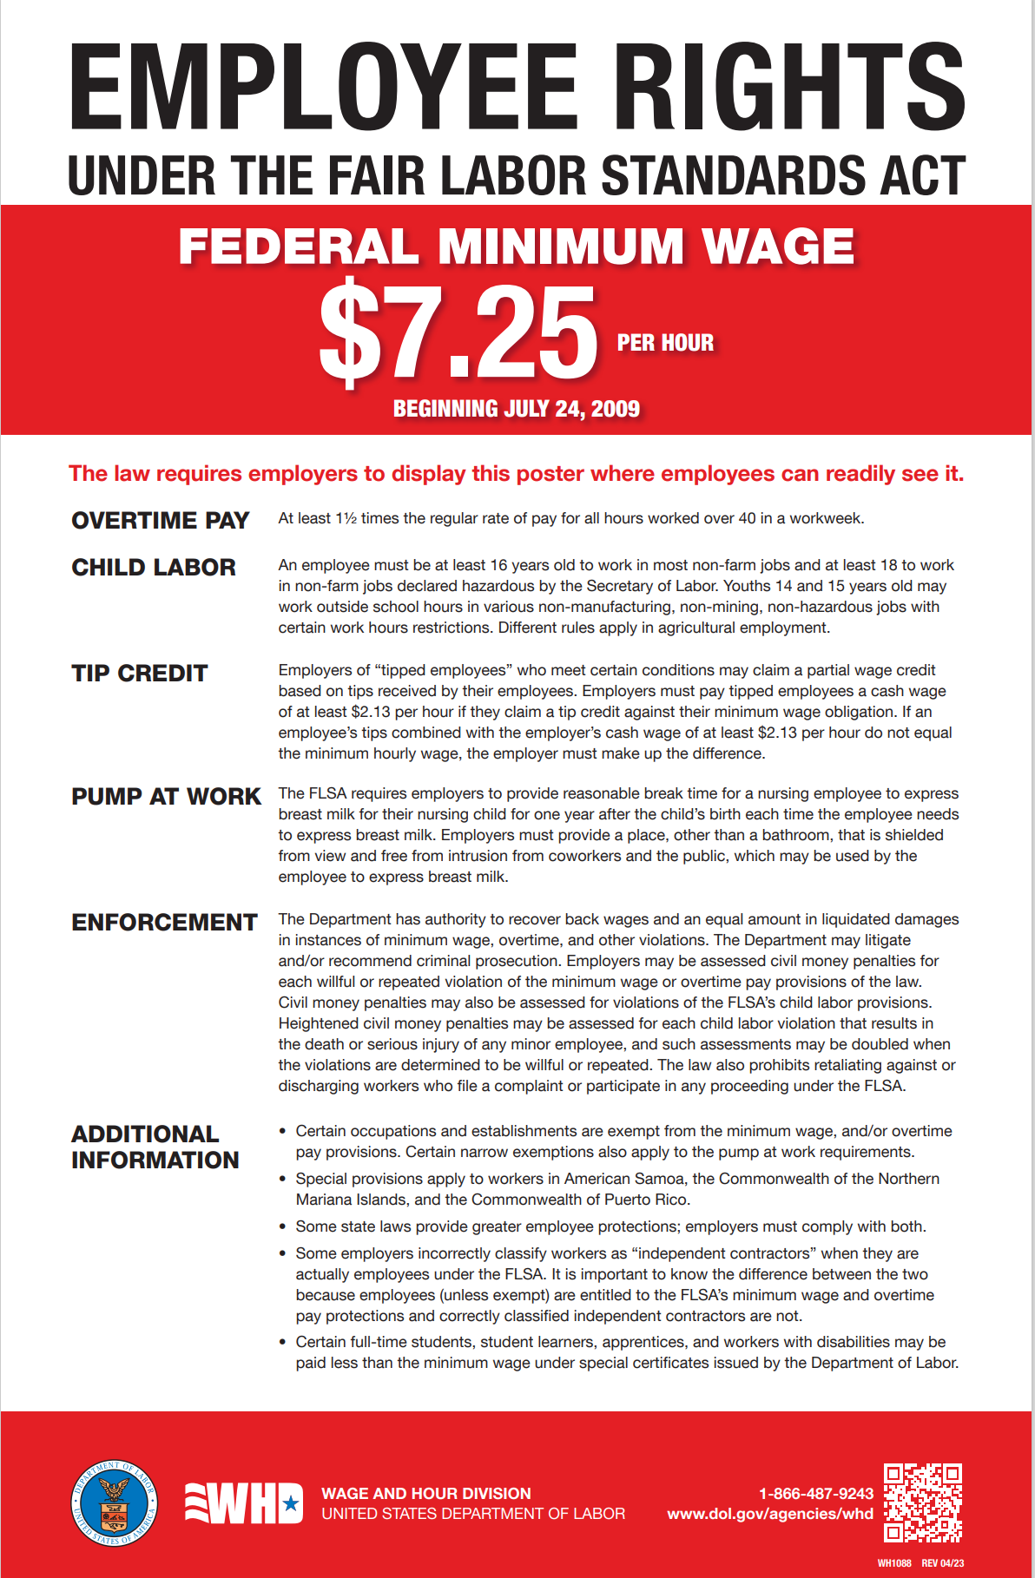
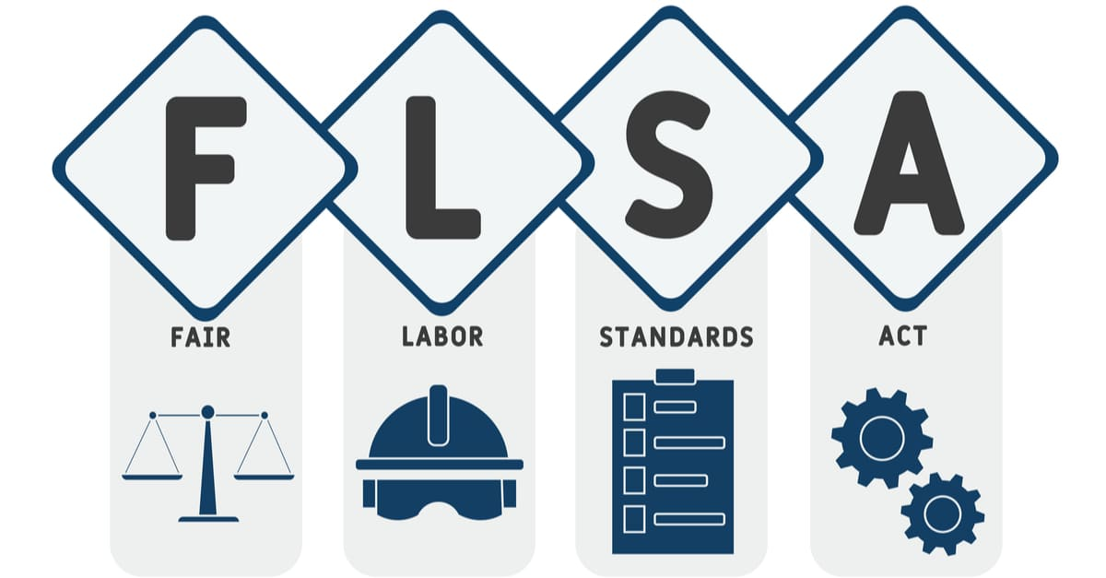
Questions?

Slide 18
October Checklist
Conduct interviews and make job offers
Onboard new hires
Attend Fall college/university job fairs
Ensure compliance with ACA requirements
Conduct campus check ins
Review fill rates

Slide 19

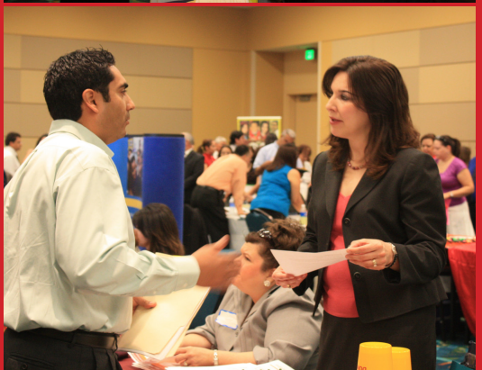
Educator job fairs
* College / University
* “Other” Majors
Dept of Labor / Unemployment Offices /Workforce Commission
Veterans Affairs
* Regional offices

Slide 20
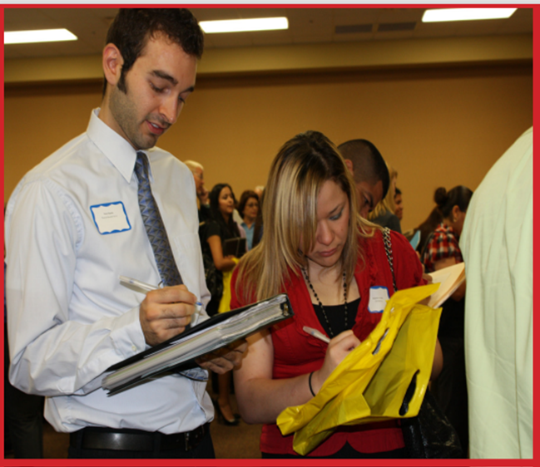

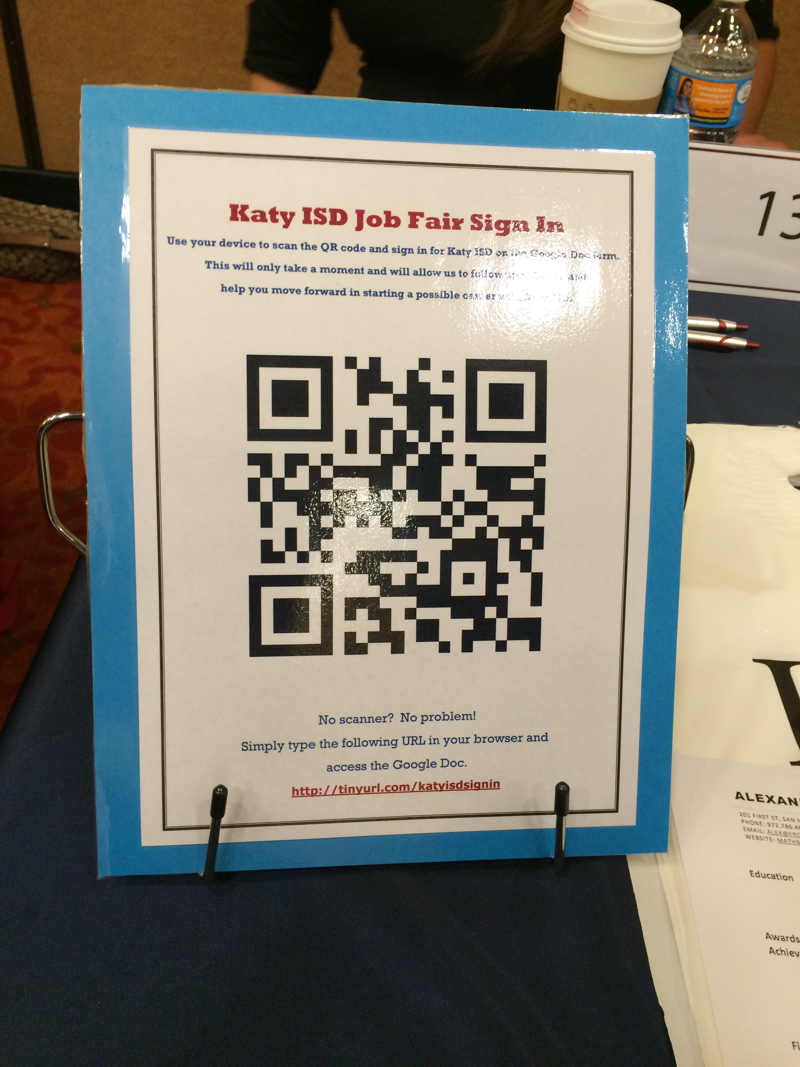
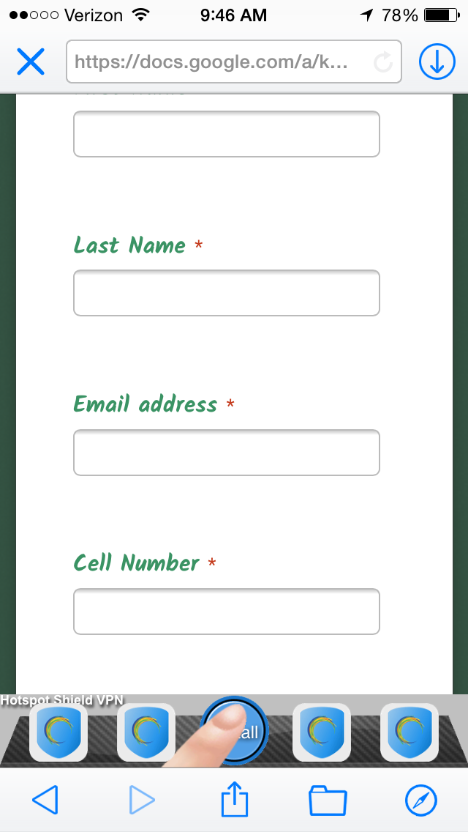

Slide 21
November Checklist
Conduct interviews and make job offers (as needed)
Onboard new hires (as needed)
Ensure compliance with ACA requirements
Conduct campus check ins
Review fill rates

Slide 22
Schedule
August 28, 2024 (Wednesday) February 12, 2025 (Wednesday)
September 20, 2024 (Friday) March 11, 2025 **
October 22, 2024 (Tuesday) April 11, 2025 (Friday)
November 19, 2024 (Tuesday) May 14, 2025 (Wednesday)
December 3, 2024** June SUBSOLUTIONS CONFERENCE
January 16, 2025 (Thursday) July 17, 2025 (Thursday)

Slide 23


Slide 24
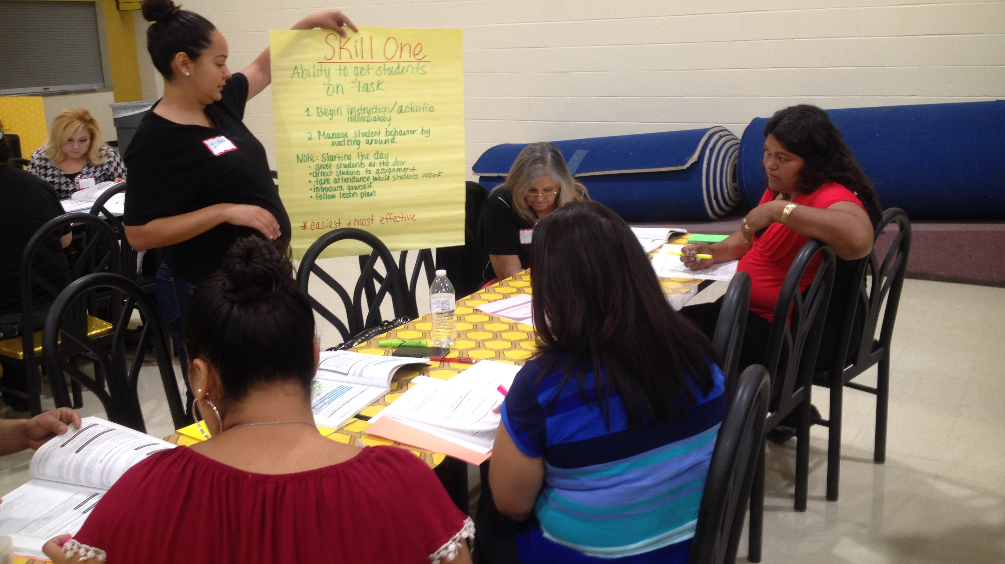
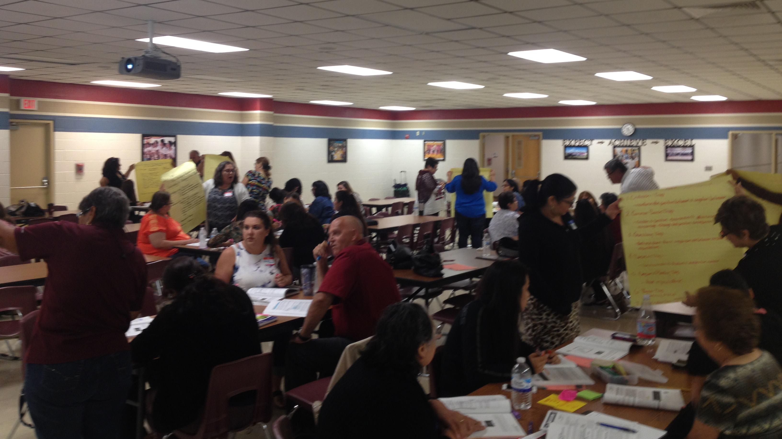
STEDI support
Online training
  Substitute teachers
  Classroom management for Teachers
On site training
  Substitute teachers
  Instructional aides

Slide 25
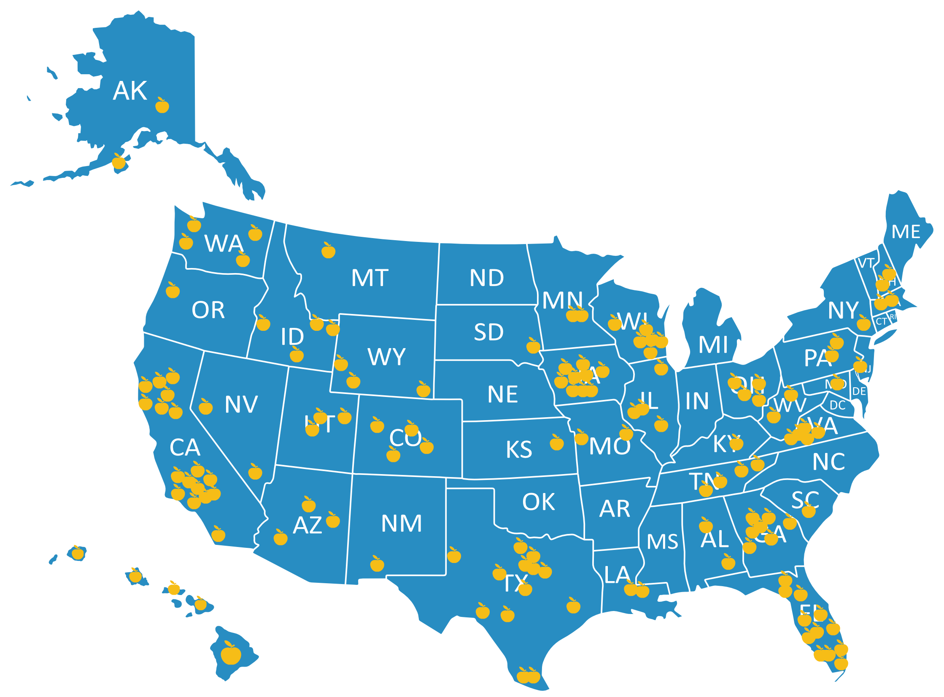

Facebook.com/stedi.org
LinkedIn.com/stedi.org

Slide 26
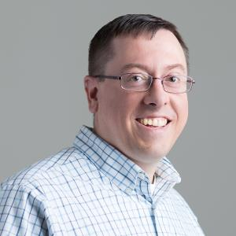
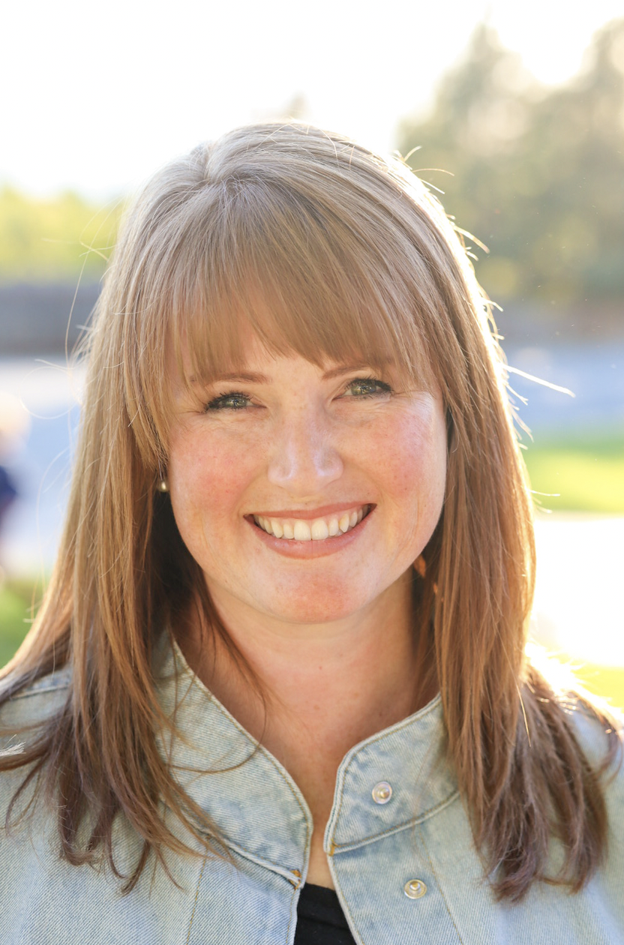

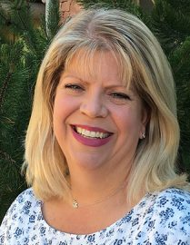

Josh@stedi.org
Jessica@stedi.org
Sheena@stedi.org
Kelley@stedi.org
Melissa@stedi.org

Slide 27


