Slide 1


July 26, 2024
Presented by
Melissa Aguero Ramirez
HR Consultant & Talent Development Director

Slide 2


Slide 3
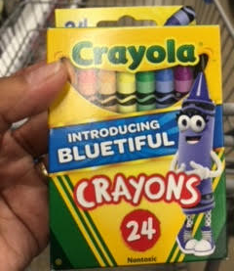
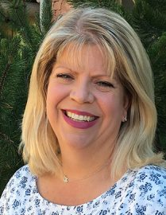



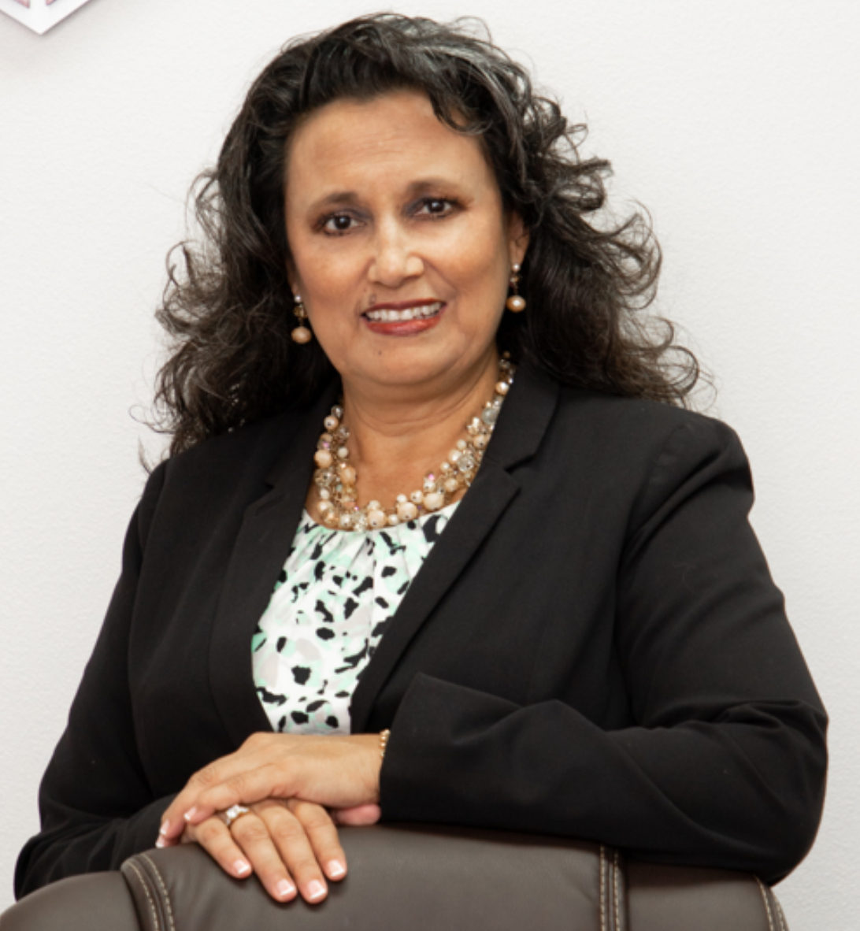
Kelley@stedi.org
Jessica@stedi.org
Sheena@stedi.org
Josh@stedi.org
Melissa@stedi.org

Slide 4

June Checklist
Verify
Verify employee handbook is updated
Purge
Purge substitute teacher list based on continued interest
Attend
Attend STEDI’s SubSolutions conference
Update
Update employee forms (as needed)

Slide 5

JULY CHECKLIST
Notify continuing substitute teachers of Back to School (BTS) trainings
Meet with campus secretaries/substitute managers
  Changes to teacher absence/substitute teacher management system and/or training
  General feedback
Meet with campus administration
  Changes to teacher absence/substitute teacher management system and/or training
  Review of campus absence data

Slide 6

August Checklist
Conduct BTS trainings
Update substitute teacher/absent management software
  Add new teachers/remove teachers who resigned
  Add new substitute teachers/remove substitute teachers who resigned
  Adjust pay rates (as needed)
  Update campus contact information (as needed)
Register for Fall college/university job fairs
Ensure compliance with ACA requirements

Slide 7
Proposed Schedule
August 28, 2024 (Wednesday) February 12, 2025 (Wednesday)
September 20, 2024 (Friday) March 11, 2025 **
October 22, 2024 (Tuesday) April 11, 2025 (Friday)
November 19, 2024 (Tuesday) May 14, 2025 (Wednesday)
December 3, 2024** June SUBSOLUTIONS CONFERENCE
January 16, 2025 (Thursday) July 17, 2025 (Thursday)

Slide 8

Training Topic Suggestions
FMLA
ADA/PWFA
Personnel law
Others

Slide 9
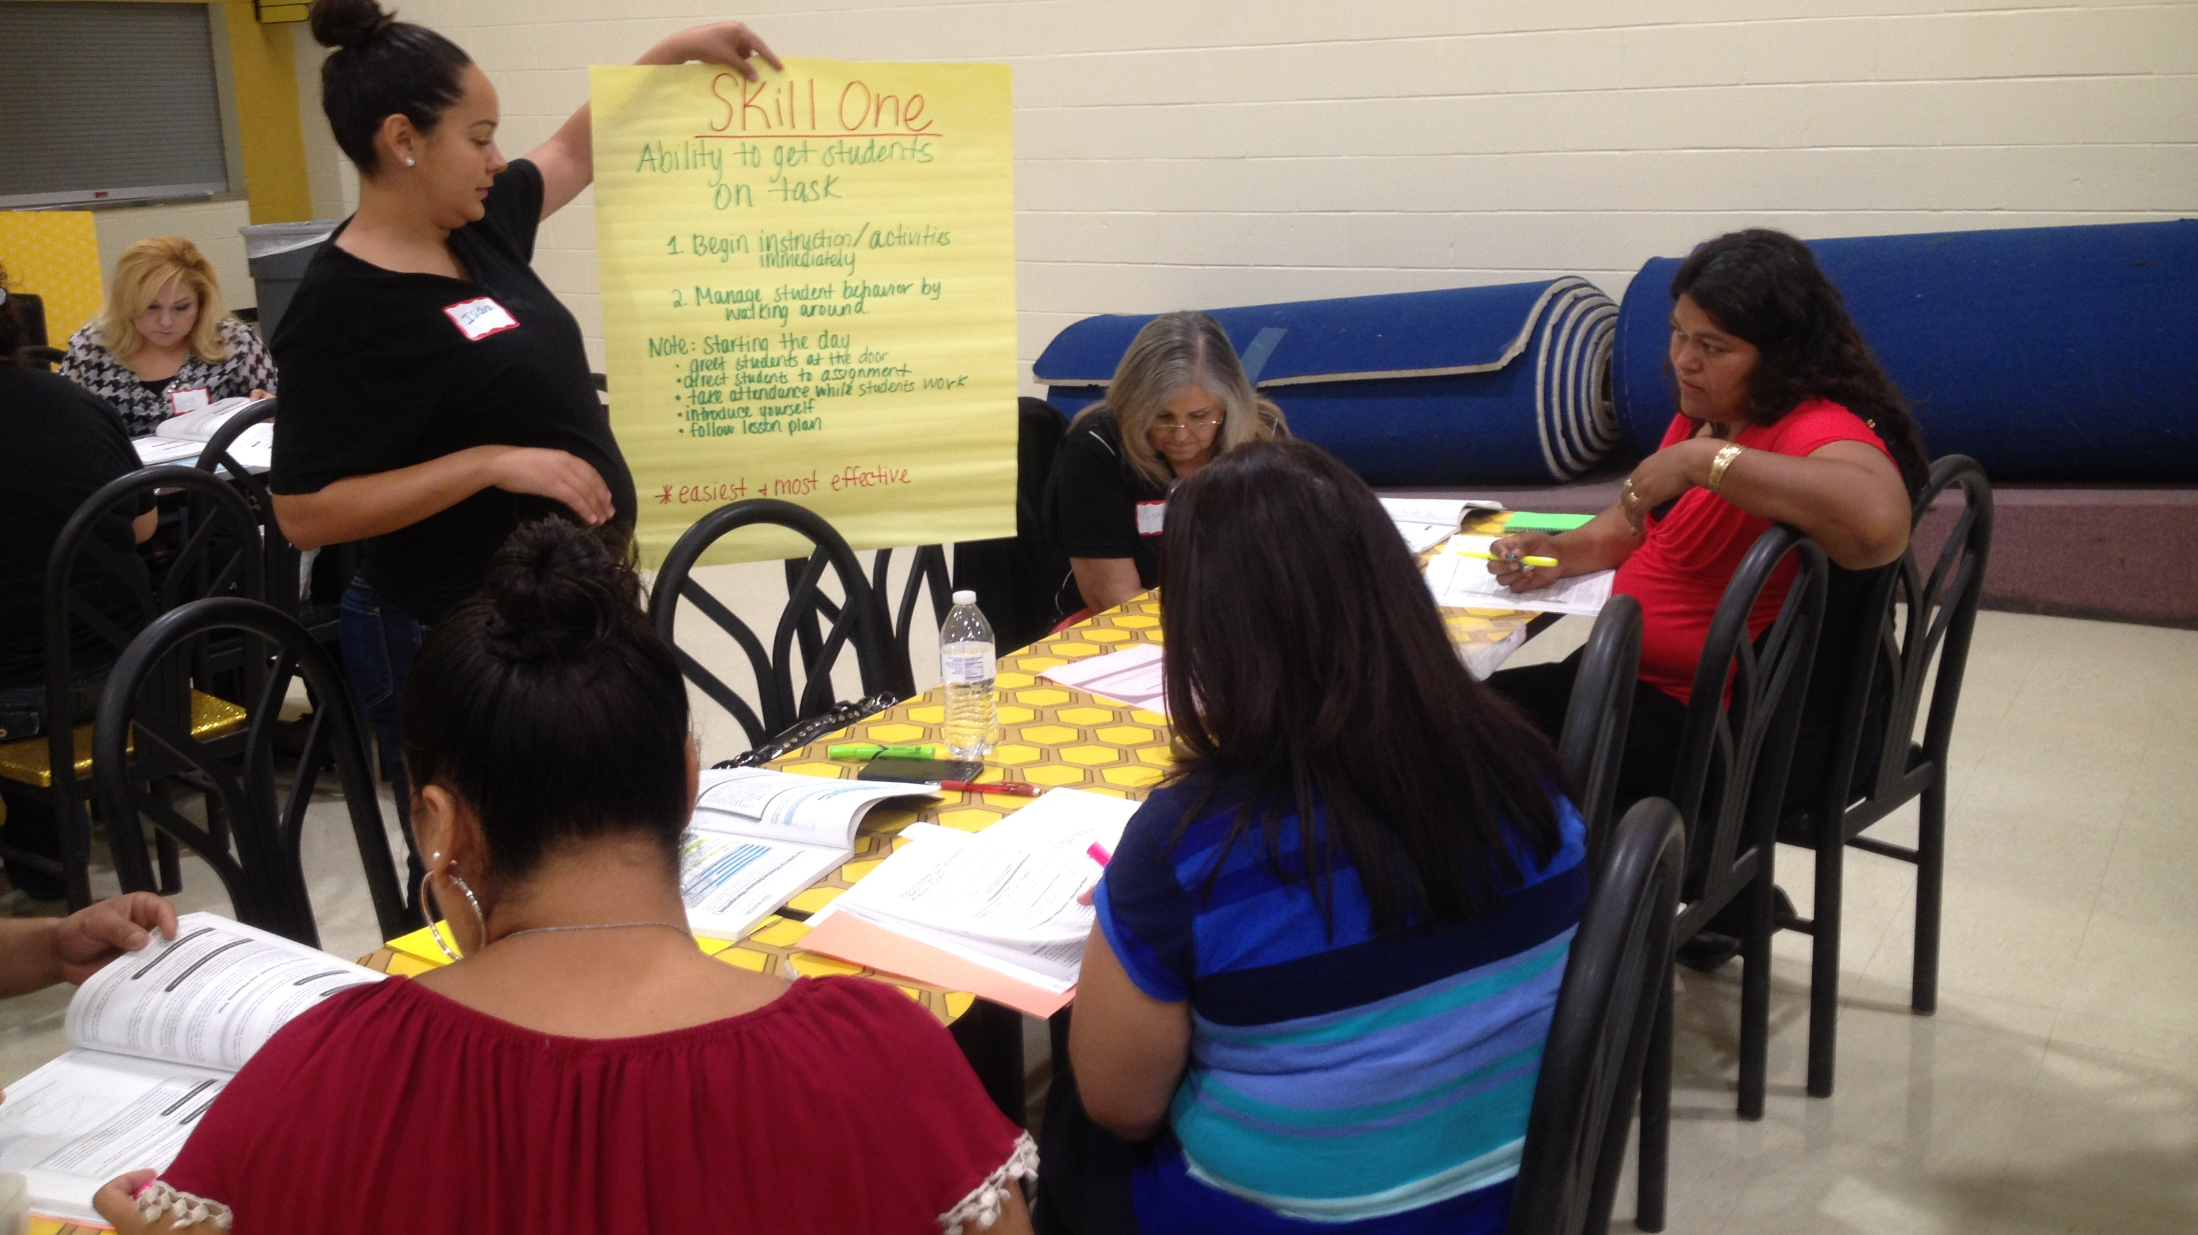
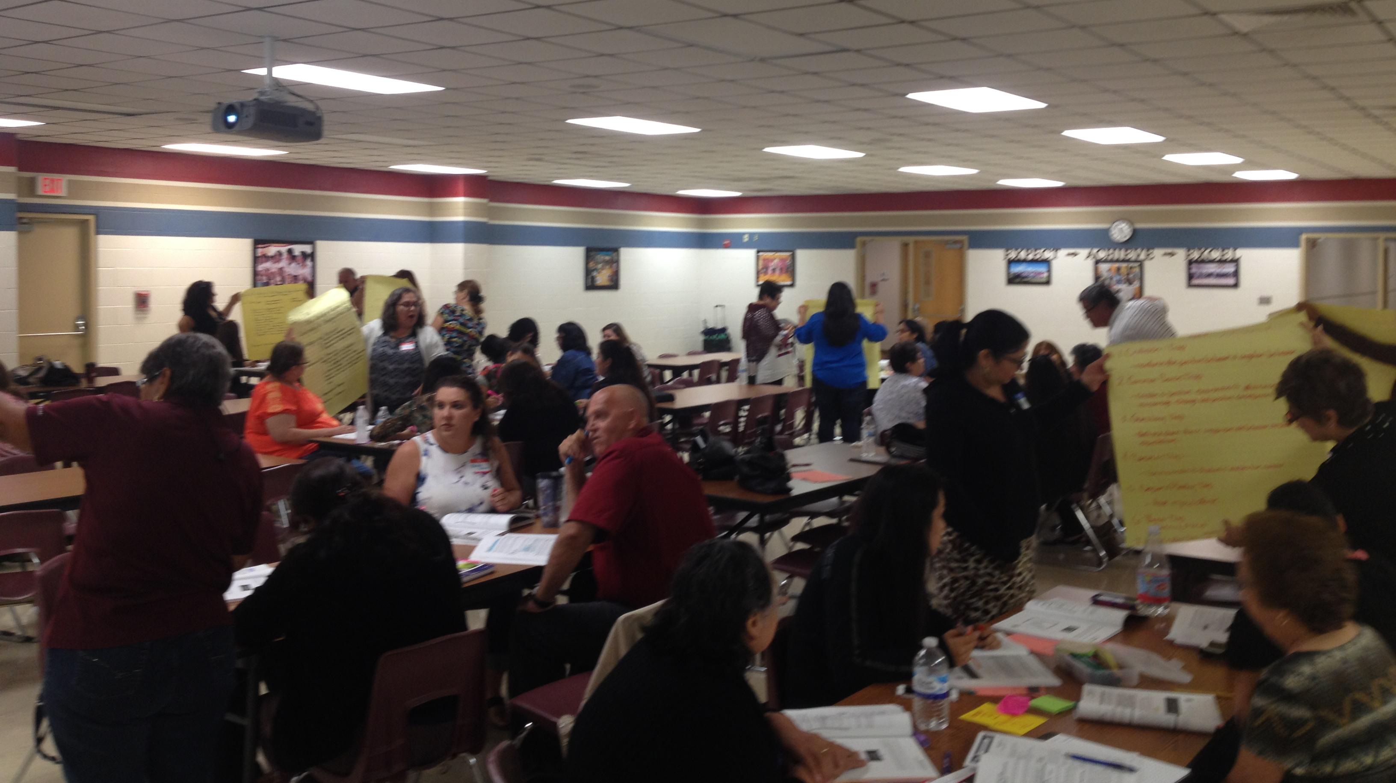
STEDI support
Online training
  Substitute teachers
  Classroom management for Teachers
On site training
  Substitute teachers
  Instructional aides

Slide 10
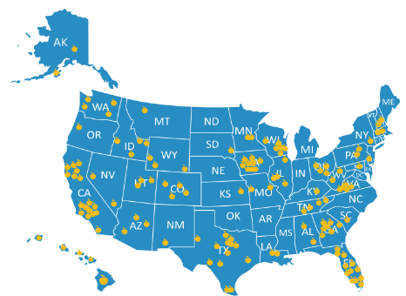
Facebook.com/stedi.org
LinkedIn.com/stedi.org

Slide 11
